Slide 1
College of Agriculture and Natural Resources
D&D
February 29, 2016

Slide 2
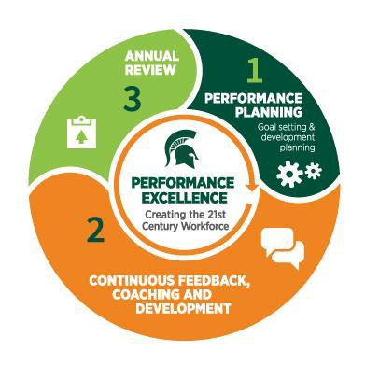
The Process & Philosophy

Slide 3
Performance Levels
Until June 30, 2016
Yes/No- “Employee meets or exceeds current expectations”
As of July 1, 2016
Does Not Meet Expectations
Developing
Meets Expectations
Exceeds Expectations

Slide 4
When Should Employees and Supervisors Start Planning Meetings?
Annual review due prior to July 1, 2016
Employees and supervisors take online class in elevateU
no later than February 29, 2016.
Conduct the review at the appropriate time. Use new review form, use current rating system (2 ratings)
Conduct Performance Planning session within 30 days of
annual review to set goals for next cycle

Slide 5
When Should Employees and Supervisors Start Planning Meetings?
Annual review due after July 1, 2016
Employees and supervisors take online class in elevateU
no later than February 29, 2016.
Conduct Performance Planning session as soon as possible to establish goals, create development plan and discuss new ratings
Conduct the review at the appropriate time. Use new review form, use new rating system (4 ratings)
Conduct Performance Planning session within 30 days of annual review to set goals for next cycle

Slide 6
Planning Meetings: New Employee and Employees New to Position
New MSU Employees
Planning meeting: within 30 days of hire
Probation/Interim review as indicated by bargaining agreement, annual review 1 year from hire.
New to Position
Planning meeting: within 30 days of starting new position
Probation at appropriate interval as indicated by bargaining agreement, or annual review at 1 year.
***Review dates will now change with position changes***

Slide 7
Planning Meeting: Tips on Setting Goals
Should support the department’s mission and/or a specific project or program.
May need to be reassessed throughout the year
Identify what is expected, allow for improvement and growth.
Number of goals will vary depending on person, position, etc.
SMART: Specific, Measurable, Achievable, Relevant, Timely

