Slide 1
Government Fiscal Sustainability Workgroup
Webinar on Covid-19 and local government fiscal response
3 April 2020, 10am EST
Covid-19 stress test on EU city governments
Emanuele Padovani
UNIBO, Department of Management
The analysis was prepared with the help of Sebastiano Botticella, Fabio Forni, and Gaia Spensieri, undergraduate students at UNIBO

Slide 2
Goal
First rough analysis of Covid-19 impact on city governments’ financial sustainability across EU

Slide 3
Data
Usage of a beta version database of financial information of city governments from LGFS-Across project
Budget solvency indicators, current balance ratios:
Current revenues (accrued)
Current expenditures (accrued, depreciation not included)
R1 =
Receipts from current operations (current cash inflows)
Payments for current operations +
Payments for debt service (current cash outflow)
R2 =

Slide 4
Method
Computation of historical R1 and R2, then the numerator (current revenues) has been reduced by the expected economy shrink
Budget solvency condition: R1 ≥ 1, R1 ≥ 1
Economy shrink (Average) = GDP decrease for current year 2020, for each country, based on analysis published by newspapers (as of 2 April); for countries where info was not available, GDP variation of 2019 adjusted for infection spread based on other countries adjustments
expected GDP decrease for 2020
Best
Average
Worst
Under review
-2,7
-4,5
-6,3
Austria
Germany
Italy
Poland
Spain
-1,5
-2,5
-3,5
-4,2
-7,0
-9,8
-3,9
-6,5
-9,1
-5,1
-8,5
-11,9

Slide 5
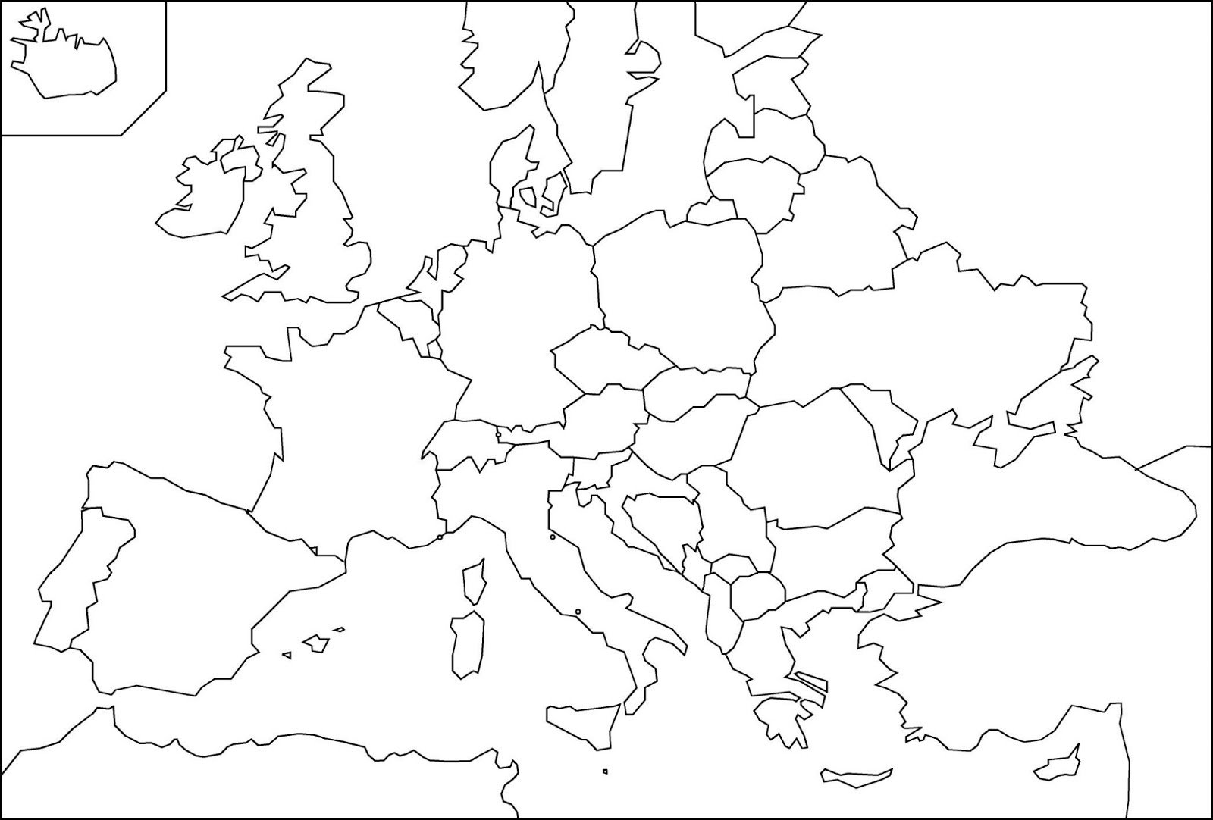
Coverage
Top 118 city governments
5 countries
Pop.: 49,1 mln (10%)
Curr. Exp.: € 170+ bln
Poland
top 20
Pop.: 8,4 mln (22%)
Curr. Exp.: € 47,1 bln
Germany
top 20
Pop.: 11,0 mln (13%)
Curr. Exp.: € 67,4 bln
Austria
Top 3
Pop.: 2,3 mln (27%)
Curr. Exp.: € 12,7 bln
Italy
top 50
Pop.: 14,6 mln (24%)
Curr. Exp.: € 18,5 bln
Spain
top 25
Pop.: 12,8 mln (27%)
Curr. Exp.: € 6,0 bln

Slide 6
Analysis R1 (accrual, without depreciation)
Poland
Current Best Worst
Germany
Current Best Worst
Austria
Current Best Worst
Spain
Current Best Worst
Italy
Current Best Worst

Slide 7
Analysis R2 (cash, with debt service)
Poland
Current Best Worst
n/a n/a n/a
Germany
Current Best Worst
n/a n/a n/a
Austria
Current Best Worst
Spain
Current Best Worst
Italy
Current Best Worst

Slide 8
Conclusions
Risk that affects several citizens living in urban areas, especially in Italy and Spain (but also Germany)
Needs of further investigation, considering debt burden and cash solvency
Difficulty to include other countries for which we have already data, but incompleted or not comparable (Bosnia i Herzegovina, France, Portugal)

Slide 9

#StayHomeStaySafe

