Slide 1

Presentation on CICILS IYOP Activities

Slide 2
About CICILS
Global Pulse Confederation
Peak Body of the Global Pulses Industry Value Chain
Not-For-Profit
Includes 18 National Associations & over 600 Private Sector Members around the world

Slide 3
Many On Board
Already!
International Center for Agricultural Research in the Dry Areas (ICARDA)
International Crops Research Institute for the Semi-Arid Tropics (ICRISAT)
International Food Policy Research Institute (IFPRI)
Commonwealth Scientific and Industrial Research Organisation (CSIRO)
University of Saskatchewan
McGill University
Michigan State University
University of Minnesota
Institut national de la recherche agronomique (INRA)
Pan American Health Organization (PAHO)
The INCLEN Trust International (International Clinical Epidemiology Network)

Slide 4
IYOP
Signature Events
March 2016
Pan African Legumes Conference
Livingstone, Zambia
Feb 2016
Pulse Conclave
Jaipur, India
May 2016 Sustainable Healthy Diets
Istanbul, Turkey
Nov 19, 2015
Sackler Event
New York City, USA
Oct 16, 2016 World Food Day
Rome, Italy

Slide 5


Sackler Institute Event (NYC) November 19th, 2015
Pan-African Grain Legume Research Conference and World Cowpea Conference, March 2016, Livingston, Zambia

Slide 6

Leo Burnett Branding Project
Announcement and unveiling of new Pulse Brand at CICILS Convention 2015 in Las Vegas

Slide 7
The Plan
Each of the proposed four thematic areas have developed workplans

Slide 8
Food and Nutritional Security and Innovation*
Sackler Institute
  Publication plan
Dryland Pulse Conf.
Sustainable Healthy Diets Conf.
Global Pulse Food Product Competition
Research on local Pulse Products
*Proposed title

Slide 9
Creating Awareness
Outward Facing Website
Recipes Program
Event Kit
Message Maps
Global Media Outreach Strategy
Promotional Videos

Slide 10
Market Access & Stability
Pulse Statistics Tracking
CODEX Reform
Commodity Exchange For Pulses
Side Events at FAO CCPR

Slide 11
Productivity & Environmental Sustainability
Pan African Grain Legume Research Conf.
Pea and Lentil Genomes announced
Publication Review
Productivity Baseline

Slide 12
Recipes Program
A recipes site will feature 2 aspects:
  National Signature Dish
  A single recipe will be selected by each National Committee to represent that country. The recipe will have accompanying video and nutritional analysis
  Recipes Database
  Any recipe submitted by a National Committee will be posted on an online database, which allows users to rate the recipes

Slide 13




Fundraising
Another $1.6 Million in Fundraising is being completed, with many more proposals nearing completion!
ILTA COMMODITIES S.A.

Slide 14

National Committees Highlights
Japan
  Booth at FOODEX Japan 2015
    Distributing 4 kinds of cookbooks, 1200 copies total
    Tasting Samples
  School Program for Japan Beans Day
    40 Elementary Schools applied, 10 selected
  Cultivation Kit Distributed
    Included seeds, fertilizer, rhizobium and a cultivation manual

Slide 15

National Committees Highlights
Turkey
  Staunch supporter of the Year
  Ministerial engagement - Food, Agriculture and Livestock.
  Planned GPC convention in Istanbul for 2016.
  Sustainable Healthy Diets Conference in 2016.

Slide 16

National Committees Highlights
Argentina
  Joint ventures with government: Ministries of Agriculture, Health and Education
  Nutritional sheets on pulses under development
  Recipe compilations
  Good agricultural practices reference manual
  Promotion of the benefits of pulses and increased consumption
  Conferences to be held in 2015: Forum for Food, Nutrition and Health; National Association of Pediatrics.

Slide 17

National Committees Highlights
Canada
  Working on production of a series of 5 minute videos to promote pulses
  Major pulse placement on television food shows
  Launch event in Toronto (January 5 tbc)

Slide 18

National Committees Highlights
UK
  Beginning outreach on securing a national level celebrity chef
  Activities underway involving Tesco as a major food retailer to promote pulses
  School programme

Slide 19

National Committees Highlights
Australia
  Formed National Steering Committees
    Activities will focus on Creating Awareness and Health and Nutrition.
  First Industry Workshop to be held in Sydney in Late August
  Planning Food festivals and Health Conferences
  Planning Outreach to Hospitality Sector – Cooking Schools

Slide 20
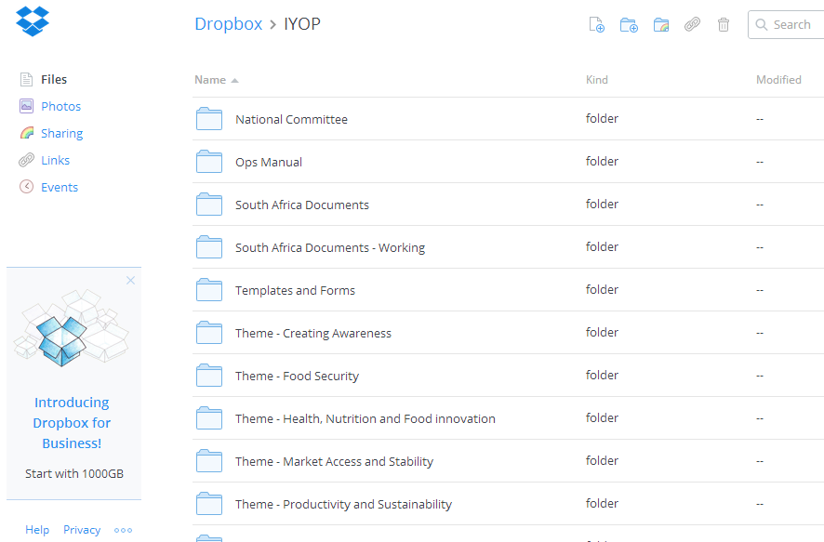
Dropbox
bit.ly/IYOPDropBox

Slide 21
Total Target Budget
$8,131,104 for IYOP Activities
  Based on Workplans developed by the Thematic Committees and approved by the Oversight Committee
  Includes items already funded, such as the Pan African Legumes Research Conference
  Running total: approx $3.1 raised and being finalized in Q1 2015

Slide 22
GET ON BOARD!
Join us in helping to plan IYOP 2016 activities!
Donate to CICILS IYOP!
Join our National Committees and plan your own IYOP 2016 Activities!

Slide 23
Visit IYOP.net

