Slide 1

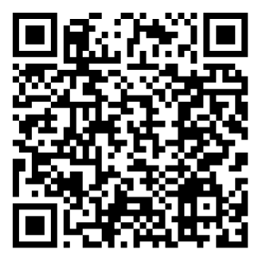

The National Farmers Market Management Survey collects insights from market managers nationwide to better understand operations, funding, and vendors. Your input helps farmers market leaders, researchers, and policymakers develop resources and strategies that strengthen markets across the country.
The survey takes just 20 minutes, and all responses are confidential. Representative results rely on ample participation and state level data will be available in states with high enough response rates. By participating, you contribute to a national effort that supports farmers markets and the communities they serve.
Questions? Visit our website at CANR.MSU.EDU/NFMS for more information or to meet the team!

