Slide 1

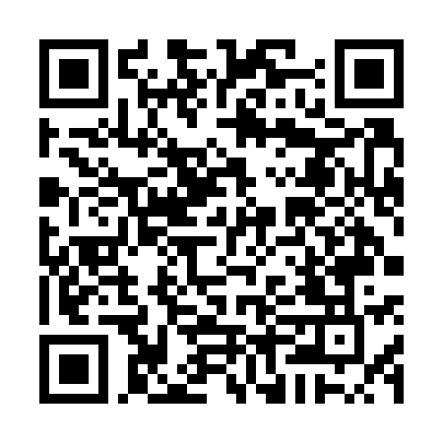
PURPOSE
This survey is designed to collect information about the structure, staffing, funding, and vendors within farmers markets across the United States. The data will help farmers market leaders, researchers, and policymakers understand and benchmark characteristics of markets today, ultimately guiding resources and best practices to support their success.
For more information,
visit our site at www.canr.msu.edu/NFMS

Slide 2

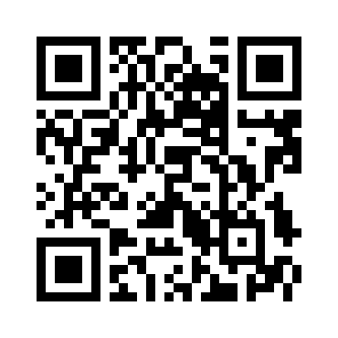
WHY PARTICIPATE
Your voice matters. By sharing your experience, you help build a national dataset that highlights trends and needs in farmers market management, allowing you to compare your market to others in your state and beyond. This information is crucial for developing strategies that ensure markets remain sustainable and continue to serve communities effectively.
Contact us:
farmersmarketsurvey@msu.edu

Slide 3



WHO SHOULD RESPOND
NATIONAL FARMERS MARKET SURVEY
We invite farmers market managers and coordinators from all regions of the United States, including territories, to participate. Whether you are new to this work or have been around for decades, manage a small or large market or markets, whether in a rural or an urban area, your perspective is essential to a comprehensive picture of farmers markets nationwide.
SURVEY DETAILS
The survey takes approximately 20 minutes to complete and covers key aspects of market structure and management. All responses are confidential and will be used solely for research purposes. Your participation helps inform future resources and support for market managers like you.

