Slide 1
Introduction to Pesticides Used in Fruit Production
Brad Baughman, MSU Extension
Horticulture Educator
Berrien County

Slide 2
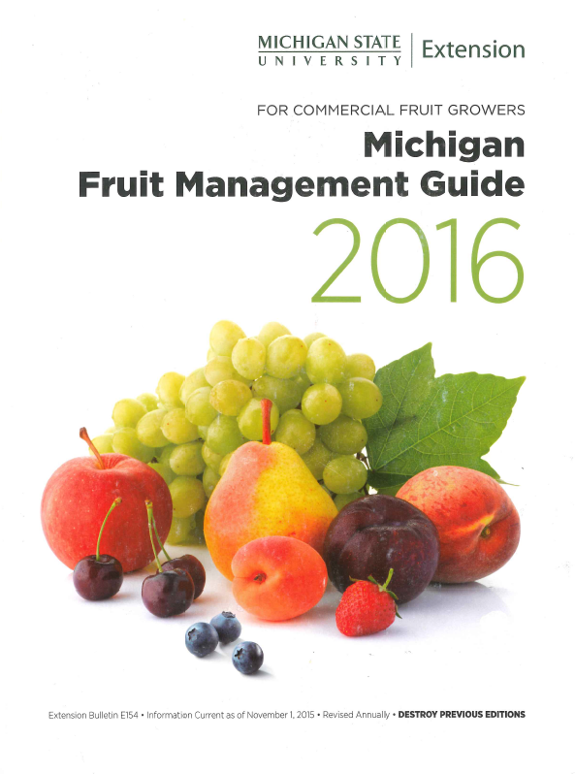
Michigan Fruit Management Guide

Slide 3
Outline
Fungicides
Insecticides
Herbicides
Divided into their chemical classes
Examples of use

Slide 4
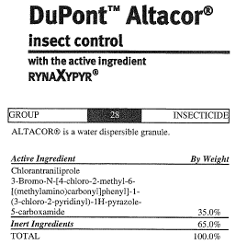
Breaking down the label
Manufacturer
Product Name
Pesticide Type
Common Name
Pesticide Class
Full chemical name
We’ll refer to the Product Name in this presentation.

Slide 5
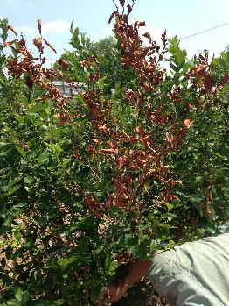
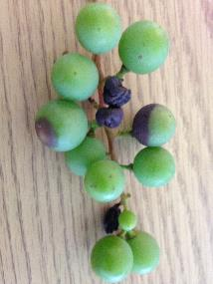
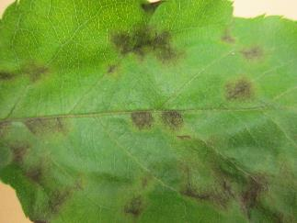
Example slide
Pesticide Class
  product example
  product example (OMRI)
  which pests it’s best on
  other pertinent info
  (OMRI) = registered for organic production

Slide 6
Fungicides

Slide 7
Types of Fungicides
Protectants
  On surface of plant - kill fungal spores as they germinate, therefore:
    Preventative only
  Kill by poisoning several sites in fungus, therefore:
    Less likely for resistance to develop
Systemics
  Absorbed into plant and kill fungus as it penetrates the plant.
  Often have back-action.
  Generally a single-mode poison:
    resistance more likely

Slide 8
Modes of Action
  Rotate FRAC codes
  throughout the season!
  Especially with systemic fungicides
FRAC code:
Fungicide Resistance Action Committee

Slide 9
Types of Fungicides
Protectants
  Salts and mineral oils (NC)
  Copper formulations (M1)
  Sulfur and Lime sulfur (M2)
  EBDCs, etc. (M3)
  Captan (M4)
  Chlorothalonil (M5)
  Biologicals

Slide 10
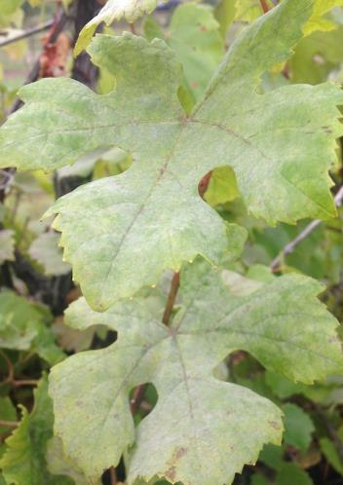
Fungicides - Protectant
Salts and Mineral oils (NC)
  Best on powdery mildew
  Armicarb, Kaligreen
    can cure powdery
  JMS Stylet Oil
    “parafinnic oil”,
    mild insecticide activity,
    wide variety of uses,
    BEWARE of tank mixes

Slide 11
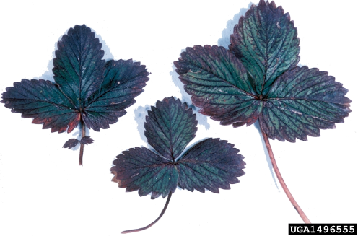
Fungicides - Protectant
Copper compounds (M1)
  Champ (OMRI), Kocide, Cuprofix
  many others –
  p. 41 in fruit mgmt guide
  beware of tank mixes and overapplication:
  can cause plant injury!
  for most products,
  add hydrated lime.
  can harm soil microbes
photo credit: ipmimages.org

Slide 12
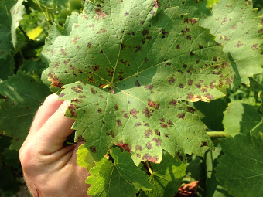
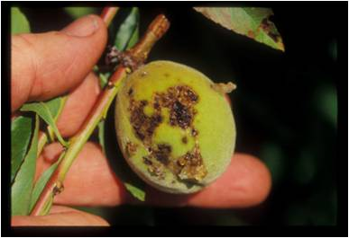
Fungicides - Protectant
Copper compounds (M1)
  use examples:
    downy mildew in grapes
    bacterial spot in peaches
    bacterial canker in cherry (apply before shucksplit)
  can also be used as dormant spray

Slide 13
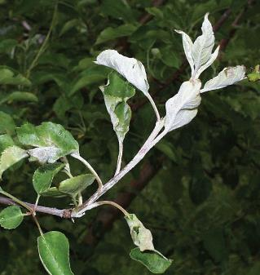
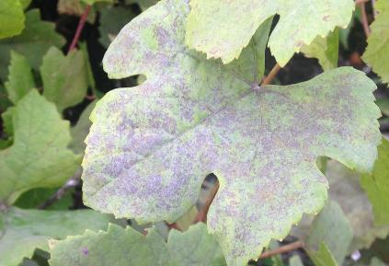
Fungicides - Protectant
Sulfur and Lime Sulfur (M2)
  best on powdery mildews, e.g. on grape and apple
  (many grapes are sensitive, incl. Concord)
  also provides S to plant
  can be used as dormant spray:
  e.g. on blueberry for Phomopsis, bacterial canker

Slide 14
Fungicides - Protectant
Captan (M4)
  active on many diseases,
  registered for everything but pears
  numerous formulations:
  e.g. W, WDG, L

Slide 15
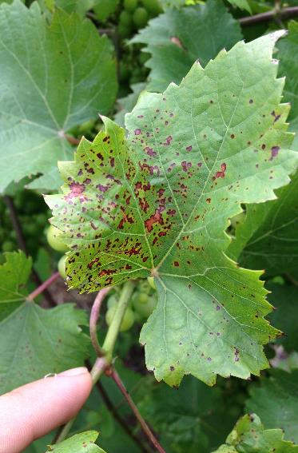
Fungicides - Protectant
Captan (M4)
  prohibited by some buyers
  plant damage very common:
    oil sprays
    slow-drying conditions

Slide 16
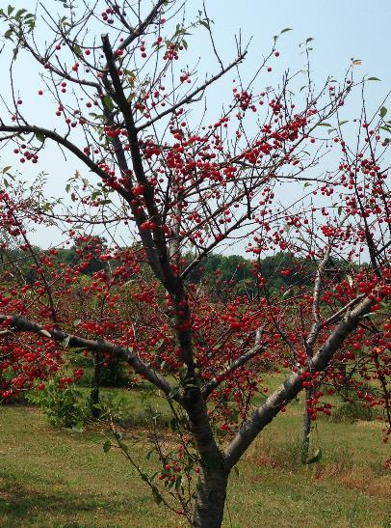
Fungicides - Protectant
Chlorothalonil (M5)
  Bravo, Echo, Chloronil, Equus
  used for cherry leaf spot.
  in most stone fruits, stop after shucksplit.
  EXCEPT tart cherry, currently 21 day PHI

Slide 17
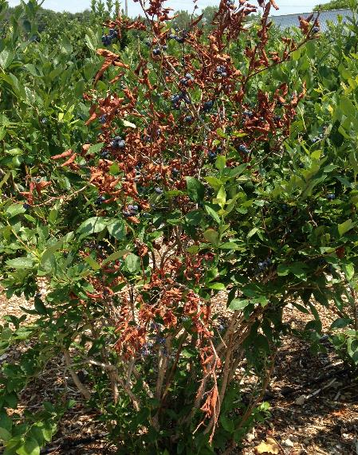
Fungicides - Protectant
Chlorothalonil (M5)
  Bravo, Echo, Chloronil, Equus
  used on blueberries for Phomopsis, Anthracnose, Fusicoccum
  mild kidney toxin – check use restrictions and PHIs!

Slide 18
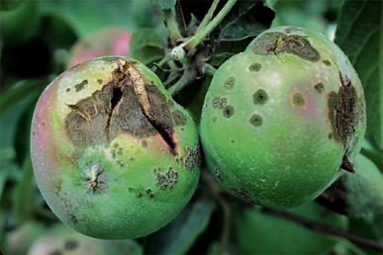
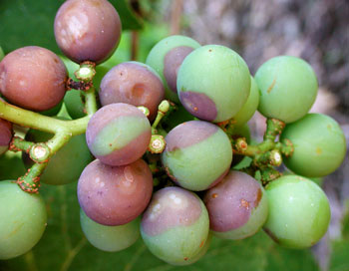
Fungicides - Protectant
EBDCs (M3)
  Dithane, Penncozeb, Manzate, Koverall
  for grapes: black rot, powdery, Phomopsis
  for apples / pears: part of scab rotation, active on numerous other diseases.

Slide 19
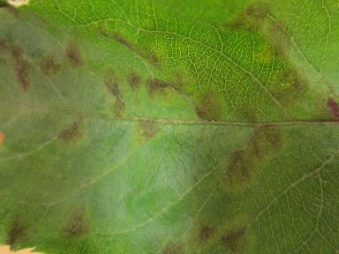
Fungicides - Protectant
EBDCs (M3)
  some buyer restrictions – always check.
  Long PHIs: 66d in grapes, 77d in apples/pears
  very low risk of resistance development

Slide 20
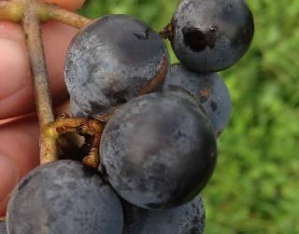
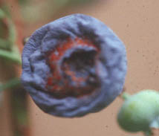
Fungicides - Protectant
Related to EBDCs (M3)
  Ferbam
  Ziram
  Thiram
  Broad-spectrum; like Captan without the plant injury.
  good on Phomopsis, Anthracnose in blueb. and grape.
  slows down summer diseases in apple
  source of Zinc nutrient

Slide 21
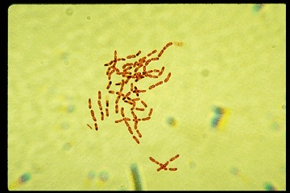
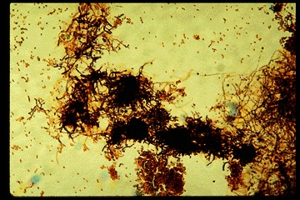
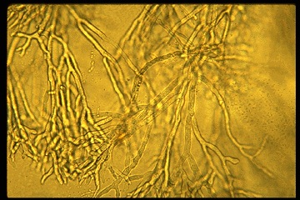
Biological Protectants
Critters rather than chemicals.
Bacteria, yeasts, other micro-organisms

Slide 22
Biological Protectants
Applied to plant surface, these microbes:
  Activate plant defenses
  Consume disease inoculum that lands where they are applied
  Secrete antibiotics

Slide 23
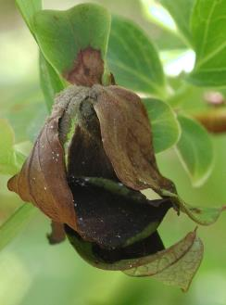
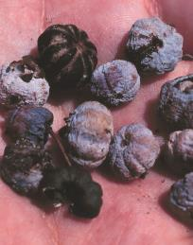
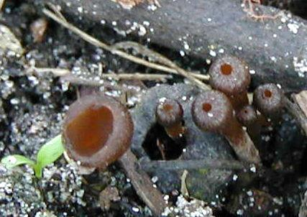
Biological Protectants
Critters instead of chemicals.
  Double Nickel (OMRI)
    broad-spectrum, labeled for many crops
    e.g. excellent control of mummy berry in blueberry

Slide 24
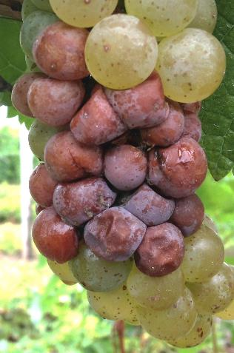
Biological Protectants
Critters instead of chemicals.
  Serenade (OMRI)
    many crops. effective vs. many diseases in rotation with stronger chem.
    sour rot in grapes.
  Sonata (OMRI)
    leaf rust, powdery mildew in grape and berry crops
  Thorough coverage necessary.

Slide 25
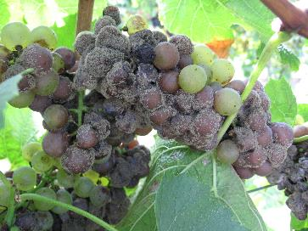
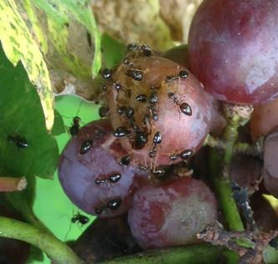
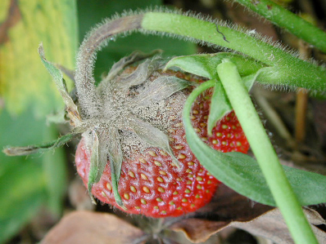
Biological Protectants
Critters instead of chemicals.
  Botector (OMRI)
    yeast
    protectant against Botrytis in grape & strawberry

Slide 26
Biological Protectants
Critters instead of chemicals.
  RootShield, Rootshield Plus, and Tenet (OMRI)
    to prevent root diseases in many fruit crops (except apple)
  BlightBan (OMRI)
    frost protection on tree fruit, blue, strawb.

Slide 27
Fungicides - Protectants
Salts and mineral oils (NC)
Copper formulations (M1)
Sulfur and Lime sulfur (M2)
EBDCs, etc. (M3)
Captan (M4)
Bravo (M5)
Biologicals

Slide 28
Fungicides - Systemic
Systemics
  Absorbed into plant and kill fungus as it penetrates the plant.
  Generally a single-mode poison:
    easier for resistance to develop
  Most effective when used in a protectant manner.
  But many have back action, and in a few situations curative ability.

Slide 29
Fungicides - Systemic
Strobilurins (11)
SIs (Sterol Inhibitors) (3)
Phosphonates (33)
Ridomil (4)
SDHI’s (7)
AP’s (9)
Others (1, 2, 12, 40)

Slide 30
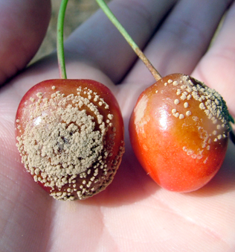
Fungicides - Systemic
SIs (Sterol Inhibitors) (3)
  Back action in many cases.
  Risk of resistance development
    Mix with protectant!
  Cherry: Indar excellent on Brown Rot. Resistance issues with cherry leaf spot and SI’s.
photo: Erin Lizotte, MSUE

Slide 31
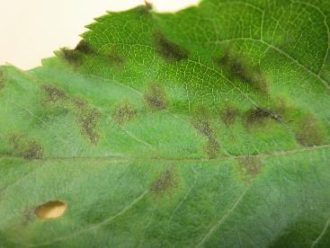
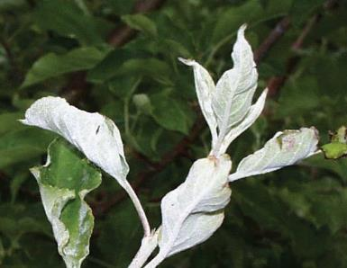
Fungicides - Systemic
SIs (Sterol Inhibitors) (3)
  Apple:
  Resistance issues with SI’s and apple scab; Indar still works.
  Rally, Vintage, Indar, Topguard all good on powdery mildew.

Slide 32
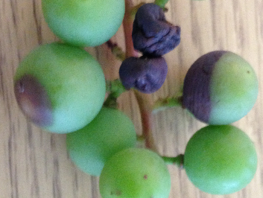
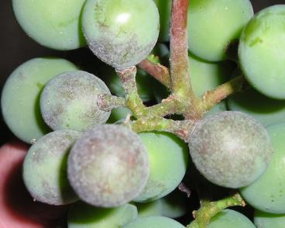
Fungicides - Systemic
SIs (Sterol Inhibitors) (3)
  Blueberry:
  Proline, Quash, Indar.
  All broad-spectrum.
  Grape: Rally and Elite for: black rot,
  powdery mildew, Anthracnose.
  Viticure esp. good on Anthracnose

Slide 33
Fungicides - Systemic
Strobilurins (11)
  Back-action in many diseases
  High risk of resistance development
    e.g. Abound in some wine grape vineyards
    e.g. Flint, Sovran in apple scab
    rec: mix with protectant (captan, EBDC, etc.) to prevent resistance development
  PHI’s in the 30-day range – always check!

Slide 34
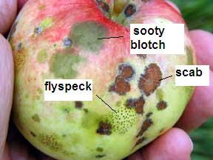
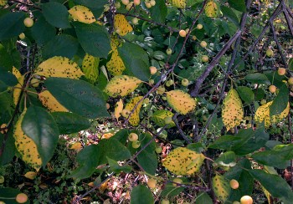
Fungicides - Systemic
Strobilurins (11)
  In apples, Flint or Sovran good vs. summer fruit diseases. Beware: Abound is toxic to apples!
  In cherries, Cabrio or Gem excellent vs. leaf spot – not YET resistant.

Slide 35
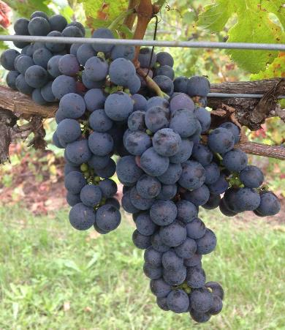
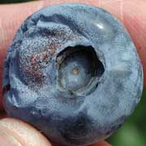
Fungicides - Systemic
Strobilurins (11)
  In grapes, Abound and Sovran effective on numerous diseases, with some back-action
  In blueberries, Abound is good on Alternaria and Anthracnose

Slide 36
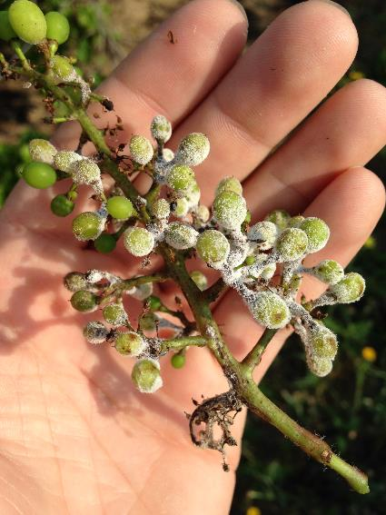
Fungicides - Systemic
Phosphonates (33)
  Agri-Fos, Prophyt, Phostrol, Rampart, Fosphite, Reveille
  Aliette, Legion, Linebacker
  grapes:
  downy mildew (+Phomopsis)

Slide 37
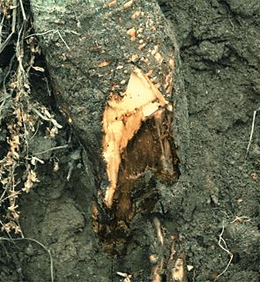
Fungicides - Systemic
Phosphonates (33)
  berries, apples, peaches: Phytophthora, Alternaria
  good back action
  penetrant – many tank mixes cause plant injury
  One of the safest pesticides (though NOT OMRI)

Slide 38
Types of Fungicides
Mefenoxam & Metalaxyl (4)
  Ridomil products, Metastar, Metalaxyl
  berries & tree fruit:
  Phytophthora & related diseases
  Ridomil Gold Copper – premix w/ Copper
  Ridomil Gold MZ: - premix w/ EBDC
    for grapes. best bet vs. downy mildew
  environmental / applicator risk

Slide 39
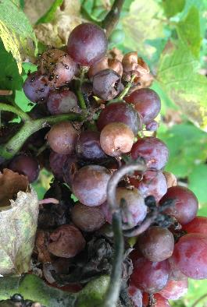
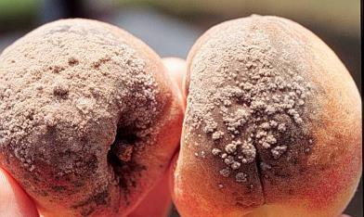
Types of Fungicides
SDHI’s (7)
  Endura
    grapes – botrytis and powdery
  Fontelis
    apples – scab & powdery , brown rot stone fruit – brown rot
    strawb – powdery mildew & gray mold
  Kenja
    grapes & berries –
    botrytis, powdery,
    anthracnose

Slide 40
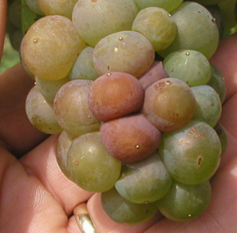
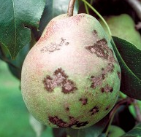
Types of Fungicides
Anilino-pyrimidines (9)
  Highly systemic, good on fruit rots & fruit molds.
  Scala / Penbotec
    apples, pears – scab
    grapes & stone fruit - fruit molds
  Vangard
    grapes, some tree fruit
  Switch
    for Botrytis in grapes & berries

Slide 41
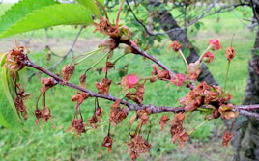
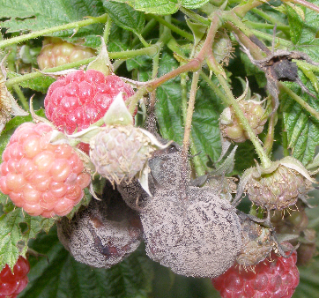
Fungicides
Others
  Topsin-M (1)
    brown rot in tart cherries
    resistance problems with other diseases
  Rovral (2)
    grapes, stone fruit, caneberries
    locally systemic, effective on several fruit rots
    resistance problems

Slide 42
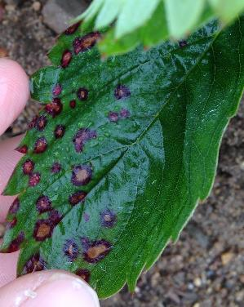
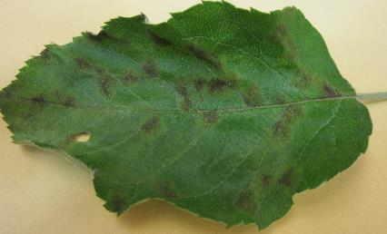
Fungicides – Systemic
Syllit
  protectant with some back-action
  apple scab,
  cherry leaf spot,
  strawberry leaf diseases

Slide 43
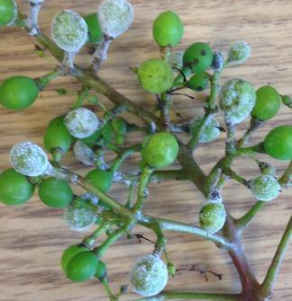

Fungicides - Systemic
Special products for grape:
  For downy mildew: Revus, Revus Top, Forum (40), Presidio, Gavel
  For powdery mildew: Torino, Vivando, Quintec

Slide 44
Types of Fungicides
Pre-Mixes
  Captevate (3 & M4)
    blueberry, strawberry, raspberry: gray mold and Anthracnose
    cherry: gray mold and brown rot
  Quilt Xcel (3 & 11)
    blueberry, caneberry, stone fruit: multiple diseases
  Quadris Top (3 & 11)
    stawberry & grape: multiple diseases
  Inspire Super (3 & 9)
    multiple crops, multiple diseases
    best used as a protectant, max 2 in a row

Slide 45
Types of Fungicides
Pre-Mixes
  Luna Experience (3 & 7)
    wine grapes only – powdery, black rot, Botrytis
  Luna Tranquility (7 & 9)
    apple – scab & powdery mildew
  Luna Sensation (7 & 11)
    excellent on leaf spot and brown rot in sw cherry
    high risk of resistance development – rotate!
  Pristine (7 & 11)
    catch-all for grapevines
  Merivon (7 & 11)
    excellent on leaf spot AND brown rot in sw cherry

Slide 46
Types of Fungicides
Systemics
  Strobilurins (11)
  SIs (Sterol Inhibitors) (3)
  Phosphonates (33)
  Ridomil (4)
  SDHI & anilinopyrimidines (7, 9)
  Others (1, 2, 12, 40)

Slide 47
Antibiotics
Streptomycin (serious resistance issues in fire blight)
Kasumin
Agri-Mycin (OMRI)
Mycoshield (OMRI) = Flameout, Fireline
peaches – bacterial spot (when Copper spray program is insufficient)
apples – fire blight

Slide 48
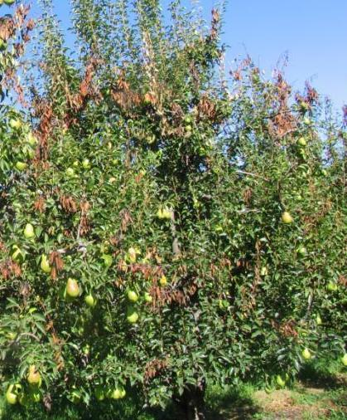
Fire Blight
streptomycin resistance widespread in SW MI
protect blossoms with Kasumin, Agri-mycin, Mycoshield, Fireline
photo: Ken Johnson, OSU

Slide 49
Fire Blight
Apogee (PGR) at bloom will reduce shoot vigor, and reduce susceptibility to fireblight
Bloomtime, Blossom Protect
  aid in protecting blossoms
photo: Ken Johnson, OSU

Slide 50


Fire Blight…
Non-chemical aspects are top priority.
  pruning out all infected material: 18-24” below infection.
  resistant varieties when possible
  resistant rootstocks
photos: Ken Johnson, OSU

Slide 51
Types of Fungicides
Protectants
  Salts and mineral oils (NC)
  Copper formulations (M1)
  Lime and Lime sulfur (M2)
  EBDCs, etc. (M3)
  Captan (M4)
  Chlorothalonil (M5)
  Biologicals
Systemics
  Strobilurins (11)
  SIs (Sterol Inhibitors) (3)
  Phosphonates (33)
  Ridomil (4)
  SDHIs (7, 9)
  Other… (2, 40, 43)
Pre-mixes
Antibiotics

Slide 52
Fruit Management Guide
See p.52 of Fruit Management Guide 2016
“Fruit fungicides that have a shared mode of action”

Slide 53




Table 3. Fruit fungicides that have a shared mode of action
Notes:
Explain:
List of most of the fungicides available, other than biocontrol agents and antibiotics, once across the top, and again across the side.

Slide 54
Rotating Fungicides
Spray program example:
  5/19 – Koverall
  6/3 – Koverall
  6/16 – Orius + Ziram
  6/29 – Rally + Ziram
  7/12 – Rally + Ziram
  8/7 – Rally
  8/23 – Rally

Slide 55

Rotating Fungicides
Ziram and Koverall are
Bis-dithiocarbamates (M3)
Rally and Orius
Sterol Inhibitors (3)

Slide 56
Rotating Fungicides
Spray program example (with rotation):
  5/19 – Koverall
  6/3 Captan
  6/16 – Orius + Ziram
  6/29 Phostrol
  7/12 – Rally + Ziram
  8/7 Abound
  8/23 – Rally
Phosphonates (33)
Strobilurins (11)
Bis-dithiocarbamates (M3)
Sterol Inhibitors (3)

Slide 57
Insecticides
(and other insect control materials)

Slide 58
Types of Insect Control Materials
Conventional Chemicals
Reduced-Risk Chemicals
Miticides
Salts / Oils / Plant Extracts
Biologicals

Slide 59
Types of Insecticides
“Broad-Spectrum” = “Conventional”
  shorter residual
  contact poisons
  often kill everything
“Reduced-risk”
  longer residual
  ingestion poisons
  often specific

Slide 60
What is “reduced risk?”
“Risk” refers to…
  Applicator, consumer, and neighbor health risks
  Non-target arthropods
    Pollinators
    Predatory insects
    Predatory mites
    Parasitoids
  Groundwater pollution
Official “Reduced Risk” EPA designation for some materials.
Ingestion poisons
  Thorough coverage
  Precise timing
Notes:
contact vs. ingestion – should it have its own slide?

Slide 61
Insecticides
IRAC = Insecticide Resistance Action Codes

Slide 62
Insecticides
Oral LD₅₀
  300-500
  300-700
  30-700
  >5,000
  >5,000
  >5,000
  >2,000
  >1,800
  >2,000
Dermal LD₅₀
  >1,000
  >2,000
  >2,000
  >5,000
  >5,000
  >5,000
  >5,000
  >5,000
  >5,000
Conventional
  Organophosphates
  Pyrethroids
  Carbamates
In Between
  Neonicotinoids
Reduced Risk
  Spinosyns
  Insect Growth Regulators
  Diamides
  Abamectin
  Tetramic Acids
  “Unconventionals”

Slide 63
Fruit Management Guide
Available at your local MSU Extension office
Also online:
  shop.msu.edu
  Extension Bookstore tab off on the right

Slide 64
Insecticides: Conventional
Insecticide Class
  Organophosphates
  Carbamates
  Pyrethroids
  Neonicotinoids
Oral LD₅₀
  300-500
  30-700
  300-700
  >5,000

Slide 65


Insecticides: Conventional
Organophosphates
  Thiodan / Thionex N
    In the middle of a phase-out
    Only strawberry 2016;
    illegal after JULY 2016
  Lorsban N
    trunk spray for borers,
    pre-bloom
    for scale, psylla, aphid, etc.
    spring bud feeders in grape
    registration withdrawn soon? We’ll see.

Slide 66


Insecticides: Conventional
Organophosphates
  Imidan
    many crops,
    NOT sweet cherries
    broad spectrum,
    buffer to pH 5.5
  Malathion / Fyfanon / Cythion
    broad spectrum, many crops
    safer than other OP’s

Slide 67



Insecticides: Conventional
Carbamates
  Sevin
    broad-spectrum, many crops
    low animal & plant toxicity
    fruit thinning >30d after bloom
  Lannate / Methomyl
    broad-spectrum, many crops
    highly toxic to bees
    DO NOT USE after opening U-pick
  Vydate
    best on mites, aphids, leafhoppers
    bearing apples, nonbearing other fruit trees

Slide 68
Insecticides: Conventional
Pyrethroids
  contact poisons, most are broad-spectrum, safer for humans, other animals
  very toxic to pollinators, predator insects
  beware - can cause mite outbreaks
  generally short residual
  Pounce,
  Perm-up,
  Asana,
  Baythroid
  Battalion
  Brigade
  Danitol,
  Hero,
  Lambda-Cy,
  Mustang Max,
  Proaxis,
  Warrior II
  Ambush

Slide 69


Insecticides
Neonicotinoids
  Systemic,
  for sap-feeding pests
  Long residuals inside plant
  leafhoppers, aphids, etc.
  highly toxic to bees
  (like OPs, Pyrethroids, Carbamates)
  relatively safe for other natural enemies

Slide 70
Insecticides
Neonicotinoids
  Foliar: Actara, Assail, Provado, Venom, Sivanto, Closer
  Soil-applied: Platinum
  Either use: Admire Pro, Belay, Scorpion

Slide 71
Insecticides: Reduced-Risk
Chemical class
Spinosyns
Bacterial toxins
Abamectin
Tetronic Acids
Insect Growth Regulators
Diamides
Oral LD₅₀
>5,000
>5,000
>1,800
>2,000
>5,000
>2,000

Slide 72
Insecticides: Reduced-Risk
Spinosyns – works through ingestion
  Delegate, SpinTor, Radiant, Entrust (OMRI)
Bacterial toxins – chemicals produced by bacteria
  Generally, ingestion required
  B.T. (Dipel, Javelin, Agree, Deliver)
  Grandevo (OMRI)
  Venerate (OMRI)
Thorough coverage and proper timing required

Slide 73



Insecticides: Reduced-Risk
Abamectin - by-product of a soil fungus.
  Agrimek, ABBA, Proclaim
  Locally systemic. Effective vs. mites, psylla, leafhoppers

Slide 74


Insecticides: Reduced-Risk
Tetramic Acids (Oberon, Movento, Envidor)
  Movento – tree fruit & grapes, two-way movement in plant
  Oberon – strawberries for mites and whiteflies
  Envidor – tree fruit & grapes, for mites

Slide 75


Insecticides: Reduced Risk
IGRs, Insect Growth Regulators –
  Generally best on moth / butterfly larvae
  Only work on immature insects; must be ingested
Notes:
why they called IGRs?

Slide 76


Insecticides: Reduced Risk
IGRs, Insect Growth Regulators
  Thorough coverage and proper timing required
  Highly toxic to targets, relatively safe for pollinators, natural enemies.
  Intrepid, Esteem, Centaur, Rimon, Confirm, Dimilin

Slide 77


Classes of Insecticides
Diamides – prevents muscle movement of insects
  Altacor, Belt, Exirel
  Relatively safe on beneficial insects
  Proper timing,
  thorough coverage
  Registered for many fruits; effective on moths, fruitworms, aphids, weevils, many other pest insects

Slide 78
Classes of Insecticides
Pre-mixes:
  Brigadier (Neonic + Pyrethroid)
  Leverage (Neonic + Pyrethroid)
  Gladiator (Abamectin + Pyrethroid)
  Agri-Flex (Neonic + Abamectin)
  Endigo (Neonic + Pyrethroid)
  Tourismo (Diamide + IGR)
  Voliam Flexi (Diamide + Neonic)
  Voliam Xpress (Diamide + Pyrethroid)

Slide 79

Miticides
Provide varying intervals of control of:
  European Red Mites, and
  Two-Spotted Spider Mites
Savey / Onager
Nealta
Vendex
Zeal
Kanemite
Envidor
Kelthane
Acramite
Magister

Slide 80
Minerals and Oils
Sluggo (bait)
Sulforix
Superior Oil
Surround (OMRI)

Slide 81
Plant Extracts
Neem Oil –
Agro-Neem, AzaDirect (OMRI), Neemix (OMRI)
PyGanic (OMRI), Evergreen

Slide 82
Biological Insect Control Mtrls.
Codling Moth Granulosis Virus (OMRI)
BeetleGONE (OMRI)

Slide 83
Types of Insect Control Materials
Conventional Chemicals
Reduced-Risk Chemicals
Miticides
Salts / Oils / Plant Extracts
Biologicals

Slide 84

Changing landscape of pesticides:
The only thing constant is change itself…
Shorter time from discovery to marketing:
expect faster pace of new products
Registrations being withdrawn as new risks discovered
Newer products usually more specific.
Necessary to do tank-mixes to get broad spectrum activity

Slide 85
Timing Example: Grape Berry Moth
Timing is important!
Notes:
Tell the story:
Here’s an adult grape berry moth on the surface of a berry. She’s about to lay an egg (##NUMEROUS EGGS?) then fly to another cluster and lay some more.
Within ## days, that egg will hatch, at which time the young larva will begin crawling over the surface of the grape until it decides to enter. So we have ## days to spray this cluster and either kill the eggs, or kill the larvae, before it goes inside the berry and our poisons can’t reach it.

Slide 86

Timing Example: Grape Berry Moth
Broad spectrum
contact poisons:
Carbamates
Organophosphates
Pyrethroids
SHORT residual,
Spray on larvae directly
# of larvae on fruit
Reduced risk
ingestion poisons:
Spinosyns
Diamides
IGRs
Neonicotinoids
LONG residual,
spray on leaf surface
BEFORE larvae hatch
810 GDD
910 GDD
Notes:
Not all the moths lay their eggs at once, right?
Some of the gbm are going to be ahead of the game, and some are going to be behind the game, and some are going to lay an egg sometime in between, and be “with the pack.”
So here’s a conceptual graph of the number of larvae crawling around on berries within a generation.

Slide 87


Timing Example: Grape Berry Moth
Spray by date, and you’ll miss the window, killing fewer of them
Vine
development
bloom
berry sizing
ripening
1 May
1 Jun
1 Jul
1 Aug
1 Sep
1 Oct
Warm year
Cool year
Moths
1 May
1 Jun
1 Jul
1 Aug
1 Sep
1 Oct
Eggs
1 May
1 Jun
1 Jul
1 Aug
1 Sep
1 Oct
Date

Slide 88


Timing Example: Grape Berry Moth
Spray by responding to trapping, and you’ll be misled
% cluster infestation moths/trap
Notes:
## Note: trapping can still be useful, because ….

Slide 89

Timing Example: Grape Berry Moth
That’s why we suggest Growing Degree Day model.
Notes:
Explain which wild grapes…

Slide 90

Timing Example: Grape Berry Moth
Notes:
##DO THIS, FIGURE THIS OUT, EXPLAIN HOW TO DO IT.

Slide 91

Enviro-weather

Slide 92

Enviro-weather

Slide 93

Enviro-weather

Slide 94

Enviro-weather
709 GDD since wild grape bloom,
Increasing by 20 or 30 GDD per day:
So we estimate 810 GDD around July 2nd.
910 GDD July 6th or 7th

Slide 95
Timing Example: Grape Berry Moth
Broad spectrum
contact poisons:
Carbamates
Organophosphates
Pyrethroids
SHORT residual,
Spray on larvae directly
# of larvae on fruit
Reduced risk
ingestion poisons:
Spinosyns
Diamides
IGRs
LONG residual,
spray on leaf surface
BEFORE larvae hatch
810 GDD
910 GDD
Jul 2nd
Jul 6-8

Slide 96
Timing Example: Grape Berry Moth
We estimated 810 GDD around July 2nd.
910 GDD July 6th or 7th
Spray Belt, Altacor, Delegate, or Intrepid
as close to July 2nd (810 GDD) as possible!
Spray Sevin, Imidan, Danitol (or other Pyrethroids) at July 6 or 7 (910 GDD).
Do your homework:
  reduce spray costs
  reduce environmental risks
  more consistent management

Slide 97




Don’t forget you have friends out there too!
earwigs
ground beetles
Harvestmen (daddy long-legs)
spiders

Slide 98





Ground predator habitat
?

Slide 99





Insect Management: Natural Enemy Habitat
mixed understory
vetch
mallow
alyssum
+plantain leaf
red clover
white clover
mixed grasses
rye
queenanne’s
lace
spotted
knapweed

Slide 100

Relative Hazard of Common Fruit Crop Insecticides
Trade name | IPR score per application
Danitol 2.4 EC | 7.26
Delegate WG | 4.59
Aqua Malathion | 3.29
Imidan 70W | 1.72
Mustang Max | 0.16
Intrepid 2F | 0.002
Dipel | NA
N
IPR = Insecticide program risk (kg AI per hectare / LD₅₀)
Notes:
REPLACE WITH NOT ORGANIC OPTIONS

Slide 101

Beehazards
Many potential ways pesticides can reach bees
Reduce exposure by following label restrictions

Slide 102

Minimizing Pesticide Risk to Bees
During bloom
  Follow the Pollinator Safety section of the label
  Use only bee safe insecticides (e.g. Dipel or Intrepid for caterpillars)
  Check MSU’s E154 Pest Management Guide
  Spray when bees aren’t active
After bloom
  Spray when bees aren’t active
  Avoid drift onto adjacent blooming habitat

Slide 103


Recommended Best Practices
During Bloom:
Follow current labels.
Select least toxic pesticides whenever possible.
  E-154 contains a toxicity table for bees by pesticide
Spray when bees are less active.
  Temp below 55°F, or after sunset
Turn off sprayer when near hives and avoid pesticide drift onto open flowers in adjacent habitat.
Do not use any insecticides during bloom while bees are actively visiting flowers.

Slide 104

Recommended Best Practices
Post-Bloom:
Communicate with beekeeper about hive removal.
Minimize flowers in orchard floor with selective herbicides or by mowing before spraying.
Avoid pesticide drift onto open flowers in adjacent habitat.
Plant non-crop flowers outside of orchards
  Native perennial plants following NRCS Tech Guide 20.
  Summer blooming cover crops.

Slide 105
Herbicides
Pre-emergent vs. Post-emergent
Contact vs. Residual
Grass vs. Broadleaf vs. Broad-spectrum
Perennial activity
Notes:
herbicides not as easy to put into categories like fungicides and herbicides.

Slide 106
Herbicides
A. Lipid Synthesis Inhibitors
B / G. Amino Acid Synthesis Inhibitors
C. Photosynthesis Inhibitors
D / E. Cell Membrane Disruptors
F. Pigment Inhibitors
K. Seedling Growth Inhibitors
O. Growth Regulators
(Other)

Slide 107
Herbicides
A. Lipid Biosynthesis Inhibitors
  Fusilade, Poast, Select
  Post-emergent
  Grass only

Slide 108
Herbicides
Amino Acid Synthesis Inhibitors
  B. Mission, Matrix, Sandea
    broadleaf (Matrix hits grasses too)
    post- and pre-emergent
  G. Roundup & generics (glyphosate)
    post-emergent only
    broad spectrum
    effective on perennials

Slide 109
Herbicides
C. Photosynthesis inhibitors
  Trellis/Gallery
    pre, broadleaf
  Evital/ Casoron
    pre-, grasses & sedges
    great on many perennials
  Sinbar, Princep
    pre- and post-
    best on newly-germinated plants
    grass AND broadleaf
  Karmex
    pre, 8-10 weeks
    grass and broadleaf
  Velpar
    pre. best on woody perennials

Slide 110
Herbicides
D. Cell Membrane Disruptors
  Treevix
    post,
    broadleaf only
  Chateau
    pre, 10-12 weeks
    grass and broadleaf
  Goal
    pre/post,
    broadleaf
  Spartan, Zeus
    pre/post,
    grass and broadleaf
  Aim
    post-emergent only,
    broadleaf only
  Venue
    post-emergent only,
    broadleaf only

Slide 111
Herbicides
Cell Membrane Disruptors
  E. Gramoxone
    post-emergent only
    short/no residual
    “chemical mow”

Slide 112
Herbicides
F. Pigment Inhibitors
  Solicam
    pre-emergent, grasses (some broadleaves)
  Callisto
    pre- and post-emergent, broadleaves and crabgrass

Slide 113
Herbicides
K. Seedling Growth Inhibitors
  Surflan, Devrinol, Prowl H2O, Kerb
  pre-emergent only.
  Devrinol & Kerb best on grasses
  Prowl H2O & Surflan are broad-spectrum

Slide 114
Herbicides
O. Growth Regulators
  Post-emergent only
  generally broadleaf
  generally good or great on perennial weeds
  causes growth abnormalities.
  Formula 40 / Weedar 64 (2,4-D)
    the best for perennials
    serious risk of permanent crop plant damage:
    MDA restrictions on use.
  Stinger/Spur
    registered for many crops
  Starane
    apple & pear only
  Quinstar
    cranberry only

Slide 115
Herbicides
Other
  Rely
    post,
    grass & broadleaf
    some perennials
  Alion
    pre,
    grass & broadleaf
    some perennials

Slide 116


Some Troublesome Perennials
Horsenettle
  Sinbar
Nutsedge
  Casoron / Evital
  Sandea
  Spartan
above: OMAFRA
right: OSU

Slide 117


Some Troublesome Perennials
Poison Ivy, Milkweed, Virginia Creeper
  Roundup
photo credit: Longstroth

Slide 118
Acknowledgements
Rufus Isaacs and Julianna Wilson –
pollinator slides
Mark Longstroth and Bill Shane –
fruit disease and insect photos

Slide 119
Thank you.
Your local Extension people are here to help. My contact:
Brad Baughman
269-235-5440
baughm30@anr.msu.edu
1737 Hillandale Rd.
Benton Harbor, MI 49022

