Slide 1
IT Services
Access Request Process
April 7, 2015

Slide 2
Access Requests
Different access request forms are used to grant access to different systems
Some requests are available on:
https://earm.itservices.msu.edu/
Others are PDFs available on either site below:
https://aissecuritycontact.ais.msu.edu/arm_index.html
https://aissecuritycontact.ais.msu.edu/ebs_arm_index.html

Slide 3
EBS HR Access Requests
Unit Time Entry Specialist – Ability to enter time worked for specific organization
Unit Time Administrator – Ability to enter and approve time worked for a specific organization
Manager Self Service – Ability to approve time entered for employees reporting to them

Slide 4
EBS HR Access Requests
Unit Administrator – Ability to initiate forms (hire, reappointment, termination, cost distribution) for employee subgroup – not limited by organization
HR Payroll Approver – Ability to approve forms submitted by Unit Administrator for specific employee subgroup, organization, and approval level
Changes should be made using an export from the existing HR workflow table and the spreadsheet should be saved, so it can be provided to the access request processor

Slide 5
EBS Finance (KFS) Access Requests
Financial Document Preparer – Ability to create/view most document types. Primary organization is specified, but role is not limited to organization
Account Reviewer Level Two – Approval of disbursement vouchers over $25,000 for specific organization

Slide 6
EBS Finance (KFS) Access Requests
Organization Content Procurement Reviewer – Approval and completion of requisitions for specific organization
Organization CAM Processor – Ability to initiate Asset documents to maintain capital assets for specific organization

Slide 7
EBS Finance (KFS) Access Requests
Some Finance System roles are assigned within the system itself including:
Fiscal Officer
Account Supervisor
Account Manager
Account Delegate
Some of these roles require that the Financial Document Preparer role be granted first

Slide 8
EBS Business Intelligence (BI) System
Some HR and Finance roles include BI reports
Check the ARM for notes about included reports
Information is also included on the Role Description document on the ARM Index
Some BI roles are not included in other EBS roles
Administrator’s Assistant (AAR)
Persistence Attrition Graduation (PAG)

Slide 9
Employee Leaving Department
When an employee leaves a department, please submit a Delete User request (available on eARM)
You can indicate if they are leaving the University or just the department
IT Services Support checks twenty systems to verify access has been removed

Slide 10
New Employee to Department
Submit new request forms for all access employee will need in their new position
If needed, security contact may request a security report for employee previously in position to identify needed access
Even if employee had access in previous position, as their previous department should submit a Delete User request

Slide 11
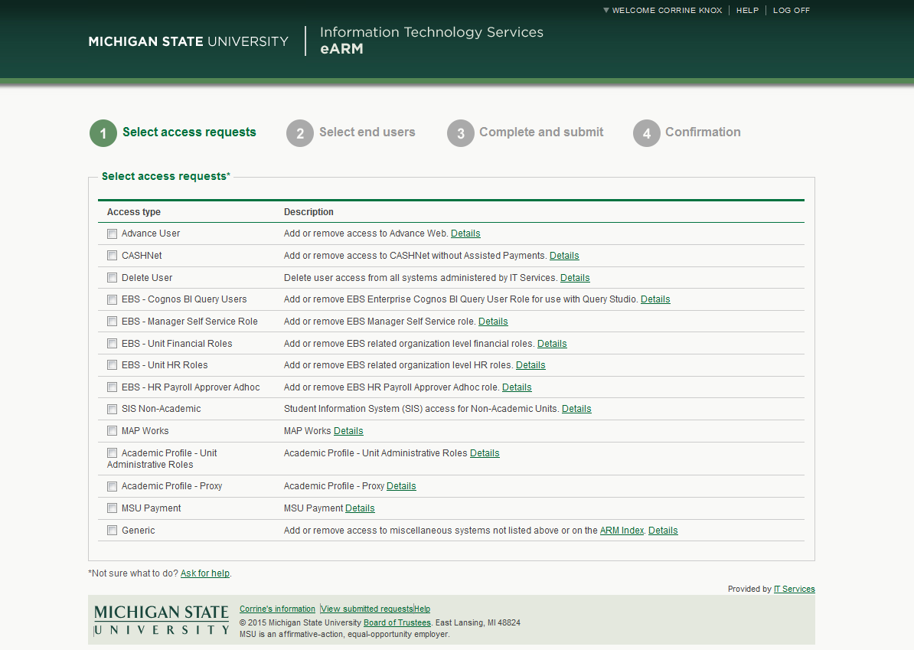
Electronic Access Requests (eARM) Demo

Slide 12
IT Services Support
Please contact us with any questions
Phone: 517-432-6200
Email: itserve@msu.edu
Chat: Link from http://help.msu.edu

