Slide 1
Two-Factor Authentication
Solution Overview
Shawn Fulton
January 15th, 2015

Slide 2
MSU Information Security Vision and Mission Statement
Vision
Diminish IT security risks to an acceptable level and become the most effective IT function; enable the University to make informed decisions based on risk.
Mission
Design, implement and maintain an information security program that protects the University’s resources against unauthorized use, modification and loss. Establish a practical information security program that enables MSU to be the best public research University in the world.
Notes:
Vision – What we would like to achieve
Acceptable Level –
We aren’t building Fort Knox (pic)
Not implement myself out of a job.
Implement enough security controls to reach an acceptable level, doesn't have to be 0 risk
Most Effective – bold goal, be service oriented
Security is an IT function
Not there to police, but to partner and collaborate
Enable - Support Bolder by Design Initiative
Not a roadblock
People seek me out for advice/guidance – not afraid to have me involved in fear of slowing projects down
Business within a business – everyone is our customer

Slide 3
Two-Factor Goals
Safe guard MSU employee data
Safe guard MSU HR/Payroll and Finance data
Provide additional security on EBS applications to prevent susceptibility to phishing attacks

Slide 4
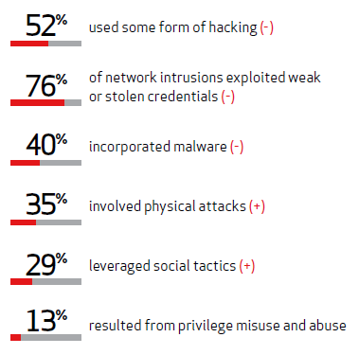
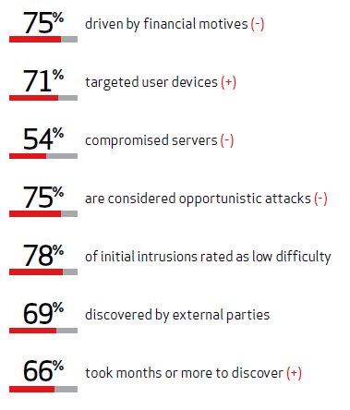
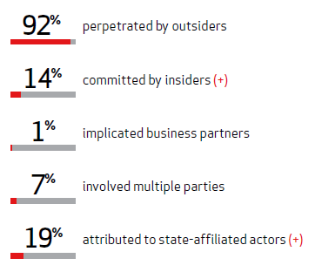
Information Security Risks for MSU
Who’s perpetrating breaches?
How do breaches occur?
What commonalities exist?
*Verizon Data Breach Investigations Report – 2013
(+) Is an increase of 10% or greater from last year
(-) Is a decrease of 10% or greater from last year

Slide 5
Payroll Incident Summary
Context:
Millions of attempts to hack into MSU computer systems every day (>20 million prevented during month of May 2014)
Millions of SPAM and phishing scams every day, some faculty, staff, and students take the bait
Current safeguards in place:
  Email SPAM filtering – Over 5 million SPAM and phishing emails blocked per day
  Anti-virus installed on workstations
  Security awareness training
Two Payroll Incident Examples
  October 2013 and March 2014
  Phishing emails are suspected of compromising the users’ EBS login credentials (user name and password)
  No breach of MSU systems/network appears to have occurred
  Risk currently mitigated by disabling online direct deposit changes
People and process changes recommended to further improve prevention, detection, and response

Slide 6
Addressing Security Risks at MSU
Defense in Depth Approach
  Multiple layers of controls to reduce overall risk
Business enablement combined with risk reduction
Two-Factor Authentication
Security Policy
Vulnerability Management
Dedicated Incident Response
Security Awareness
Security Incident and Event Management

Slide 7
Two-Factor Authentication Overview
Two-factor authentication requires the use of two of the three authentication factors:
  Something only the user:
  Knows (e.g. password, PIN, secret answer)
  Has (e.g. ATM card, mobile phone, hard token)
  Is (e.g. biometric – iris, fingerprint, etc.)

Slide 8







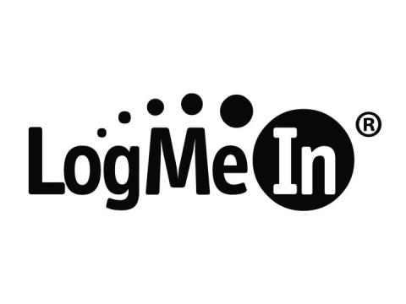





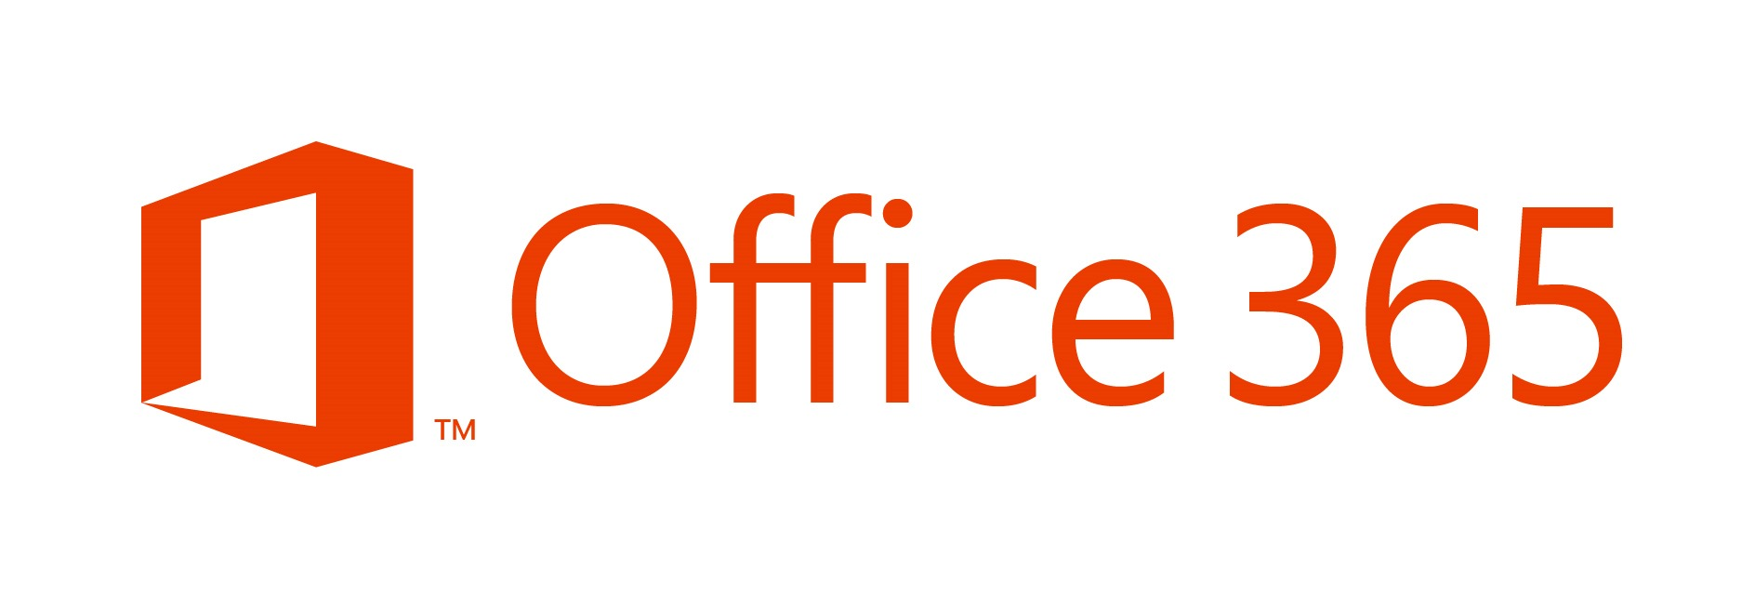




Who Uses Two-Factor?

Slide 9
How Two-Factor Authentication Helps
Credentials are commonly stolen through:
  Phishing attacks targeted at MSU
  Third-party sites compromised and same username/password used for MSU applications
    Adobe, Yahoo, LinkedIn, Forbes, Zappos, and eHarmony were breached in past year, 32 million usernames and passwords stolen
      15,000+ users registered with MSU email addresses, unknown how many used MSU password to register with these sites
Two-factor authentication prevents attackers from accessing your account even if they obtain your username and password.

Slide 10
Two-Factor Strategy at MSU
Second Factor will be a“soft” Token
Identify an Industry Leader for the Two-Factor Components
Enhance MSU’s single sign-on solution (Sentinel) to integrate with Industry Leaders Solution to provide Two-Factor
Enable Two-Factor for EBS applications (portal, HR, Payroll, Finance, BI) for all current employees.

Slide 11
Two-Factor Authentication Deployment Options
Multiple deployment options available for MSU users:
  Mobile application
  SMS text message
  Voice call made to desk, mobile, or home phone

Slide 12
Appendix A – Scope diagram

Slide 13
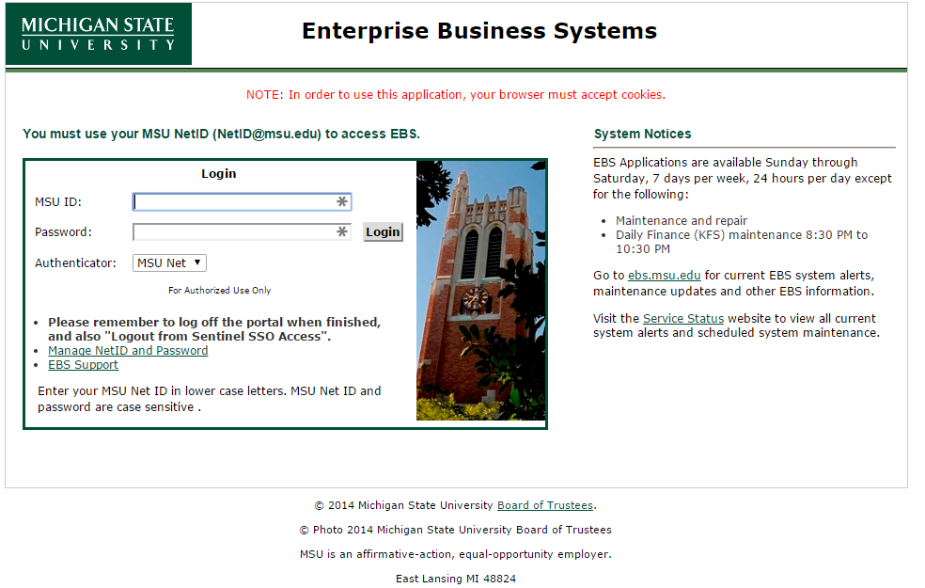
Appendix B – Enrollment: Step 1

Slide 14
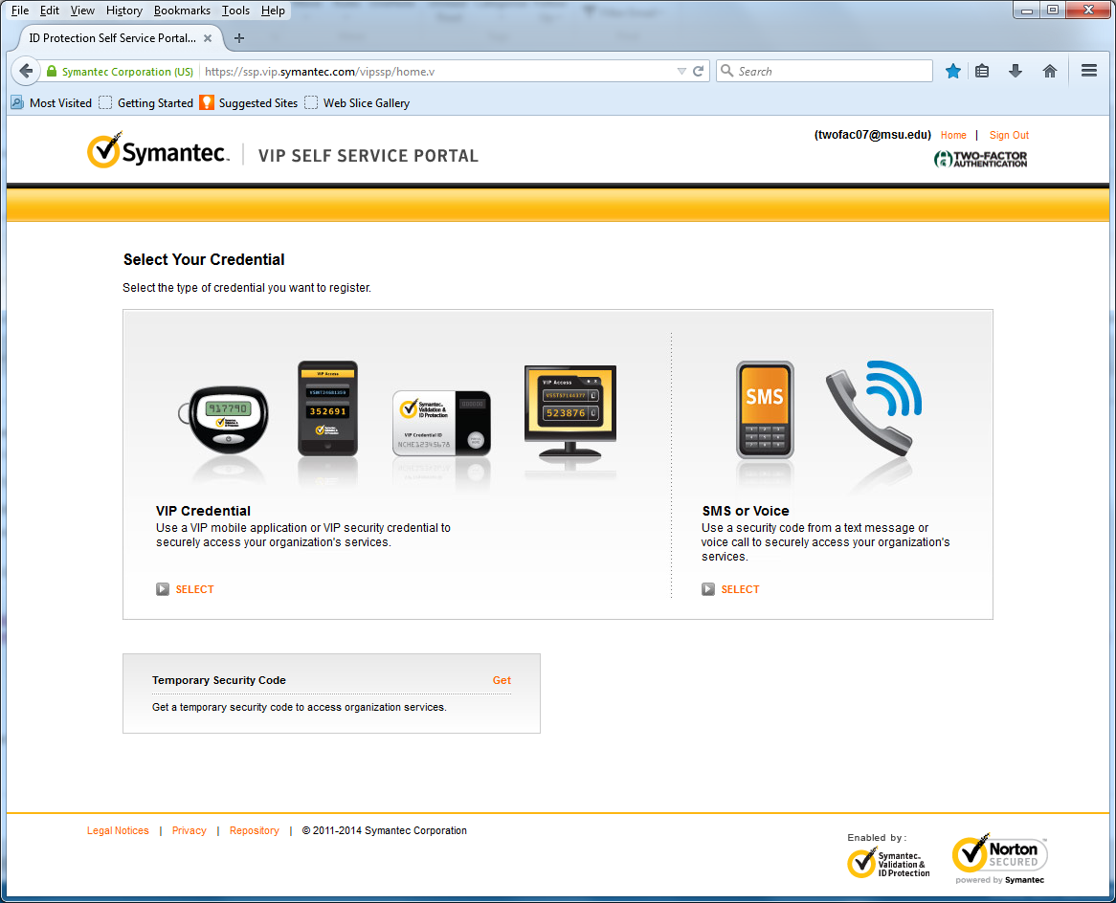
Appendix B – Enrollment: Step 2

Slide 15
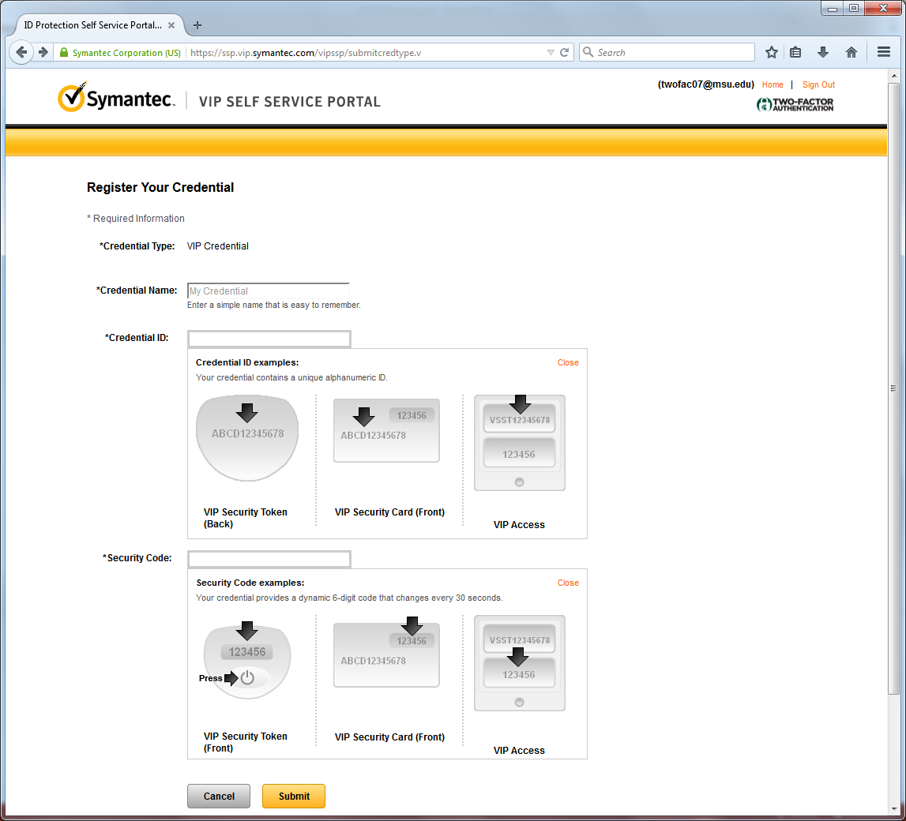
Appendix B – Enrollment: Step 3

Slide 16
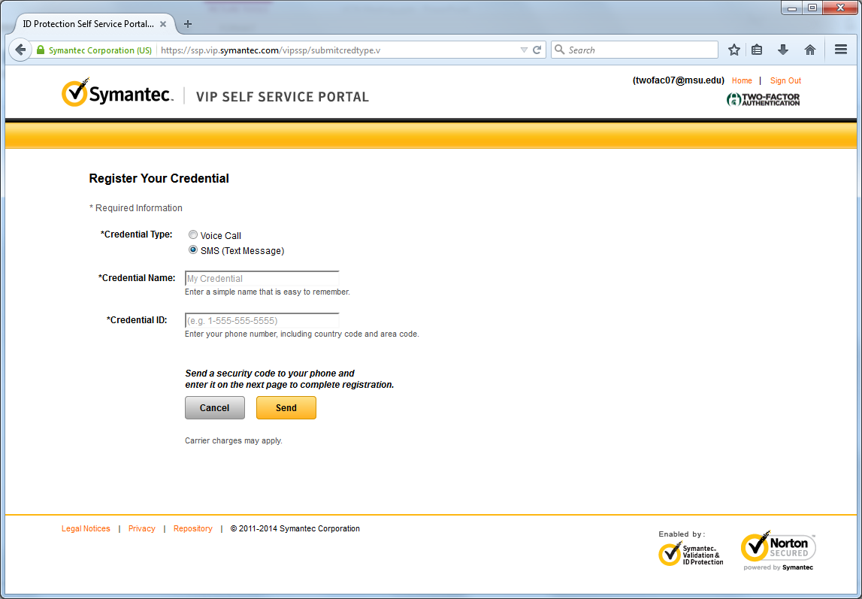
Appendix B – Enrollment: Step 3

Slide 17
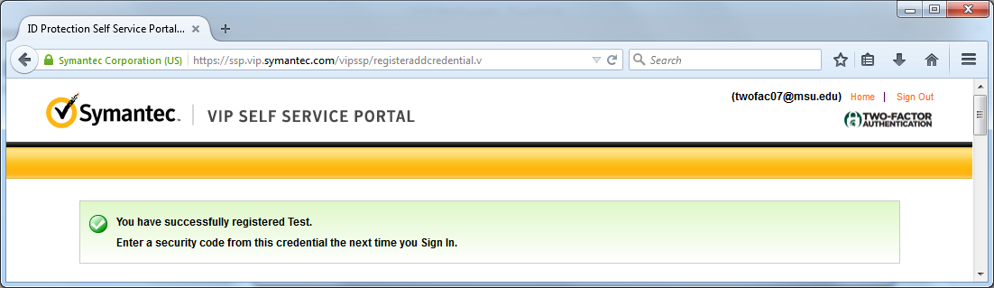
Appendix B – Enrollment: Step 4

Slide 18
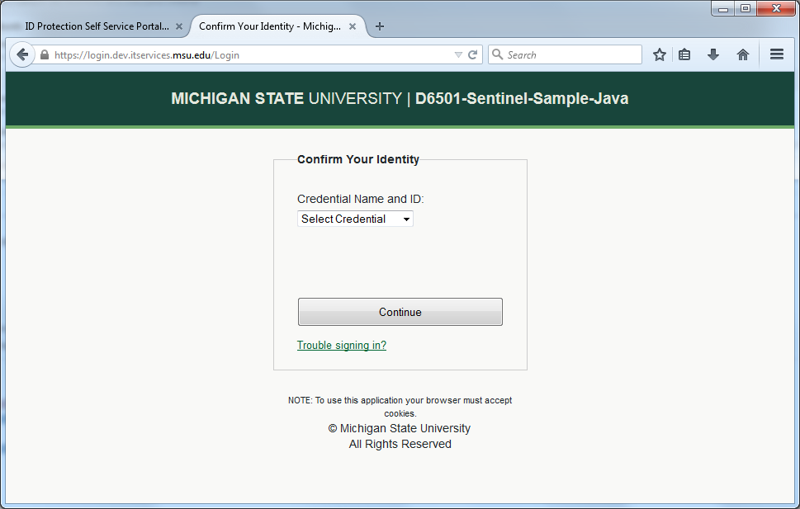
Appendix C – Login

