Slide 1
Implementing Electronic I-9s
HR Unit Representatives
Melinda Grubich
May 28, 2014
1

Slide 2
What is an I-9?
Verification of identity and employment authorization of individuals
hired for employment in the United States
Required for employees hired after November 6, 1986
Employee must complete Section 1 on or before 1st day of
employment
Section 2 of the I-9 form must be completed within 3 days of
employee’s date of hire by an MSU Authorized User
2

Slide 3
Why Compliance Matters
Civil Penalties
Violations of I-9 requirements (paperwork):
$110 - $1,100 per I-9
Consideration given to history of compliance, size of business and good faith of the employer
Knowingly hired or continuing to employ
$375 - $3,200 per unauthorized employee (1st offense)
$3,200 - $6,500 (2nd offense)
$4,300 - $16,000 (subsequent offenses)
Criminal Penalties – Up to $3000 and 6 months prison

Slide 4
Why Are We Going To An Electronic I-9 Process?
Streamline and have a consistent I-9 process
Ensures I-9s are completed correctly
I-9s are centrally located electronically
Identifies duplicate I-9s
Identifies/issues re-verification for non-residential aliens
Reduces/eliminates compliance fees if audited
Produce tracking reports for:
Pending I-9’s Section 1 completed
Expired I-9’s for non-residential aliens
4

Slide 5
New Electronic I-9 Program with Equifax
Three Components with Equifax
Electronic I-9 – Summer 2014
The Work Number
Verification of Employment
Late Fall 2014
E-Verify
Rollout TBD
Target Early 2015

Slide 6
What Is Impact On Units?
Process stays same – Format changes
Hiring unit sends I-9 email notification to new employee
Employee will complete Section 1 online or onsite at MSU
MSU authorized user will electronically complete Section 2 of the I-9
Paper I-9 form or additional documents no longer sent to central HR
Benefits
Decreases manual handling
Increased compliance reporting
Reduction of duplicate I-9s
Elimination of errors
Reduction of paper and misplacement of I-9 forms
6
Notes:
upon acceptance of job offer or include in new hire packet
Significant fines. Increased auditing being done by federal government.

Slide 7
When Will It Change?
I-9 Rollout Schedule
Early June: Go-Live for Central HR (Support Staff)
Mid June: 2 Pilot groups – RHS and IPF
Late June: Begin training for all units
Summer 2014: Rollout to remainder of Campus (FAS, students, etc.)
7
Notes:
Add an academic program
Roll out based on feedback in pilot programs

Slide 8
1-9 Next Steps
Training:
Week of May 12th: Trained pilot groups
May 28th: Presentation at Unit Rep Meeting
Summer 2014: Training units
Training seminars (similar to ACA training)
Educational Materials:
Website similar to University of Minnesota (http://www1.umn.edu/ohr/payroll/i9regs/index.html)
FAQ’s
Toolkit for unit hiring staff
Webinar
Execute Communication Plan – Ongoing
Continued Conversion Effort
8
Notes:
Minnesota website
Midst of multi month effort to digitize I-9 as part of the process we have identified duplicates. Ok in some instances
Identified where missing I’9 and may reach out to unit for missing I’9 to secure them. There are fines associated with this so important part of conversion effort.
When you introduce the video, please note to the group that we specifically asked Equifax to record a very short informal demo for us - this isn't a canned demo that they professionally produced per se. Note that the training demo we will use is more detailed (ex. 15-20 minutes). I want them to understand that this demo was done for a special purpose to just give them a chance to see the look and feel of the tool.

Slide 9
Questions?

Slide 10
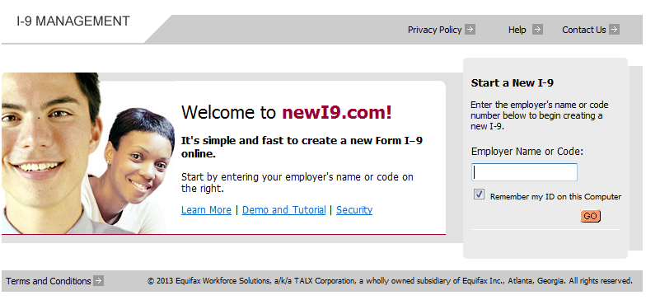
New Employee Process – Step 1
The employee will access the I-9 (www.newi9.com) site and enter the Employer Code.

Slide 11
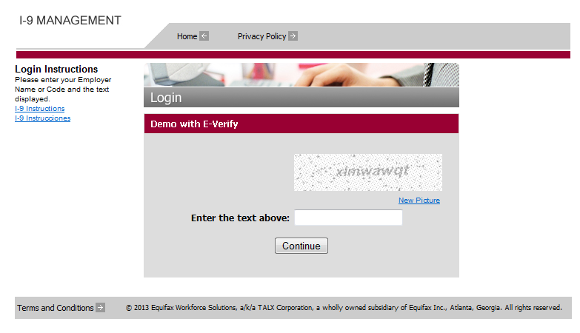
New Employee Process – Step 1
The employee will be prompted to enter the text that appears in the box – this is for added security. The employee will then click Continue.

Slide 12
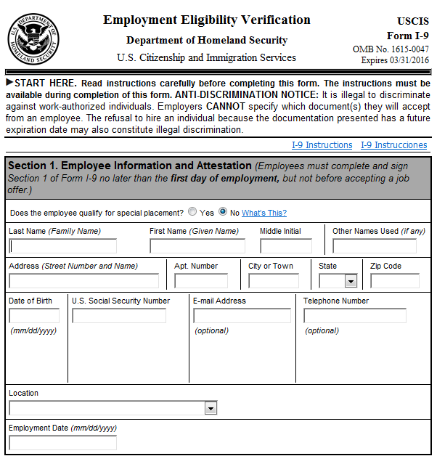
New Employee Process – Step 2
Section 1 of the I-9 form appears on the screen. In the text boxes provided, the employee enters the required Section 1 fields.
The employee will not be able to progress to the next page if required information is not completed.

Slide 13
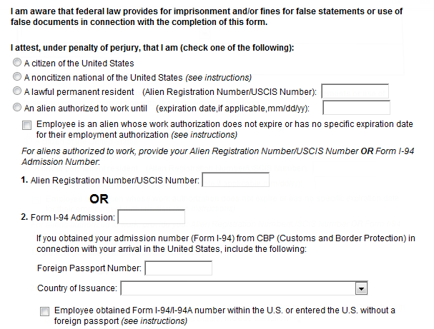
New Employee Process – Step 3
The employee then selects the appropriate Citizenship Status option.
If either Lawful Permanent Resident or Alien Authorized to Work is selected, required information such Alien number or I-94 number must be provided.
Click Continue.
A message will appear at the top of the page if any required information
was missed. All missing information will be highlighted in green.

Slide 14
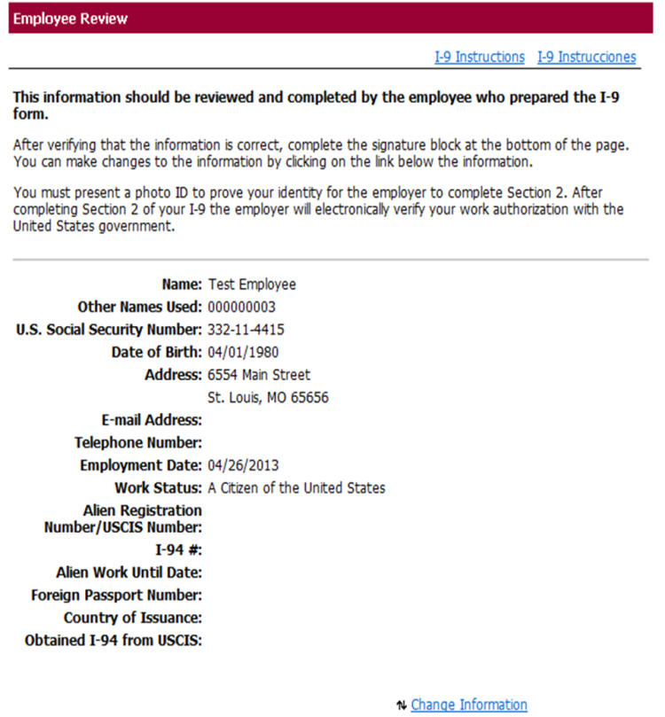
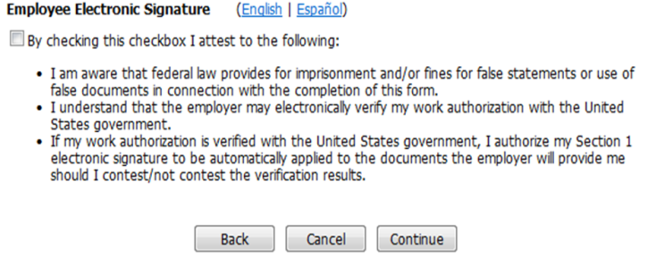
New Employee Process – Step 4
A review page will appear to let the new hire confirm their entered data.
After the employee reads the statements at the bottom, they will check the box for their electronic signature, and click continue.
If any information is incorrect the employee can change it by clicking the “Change Information” link.

Slide 15
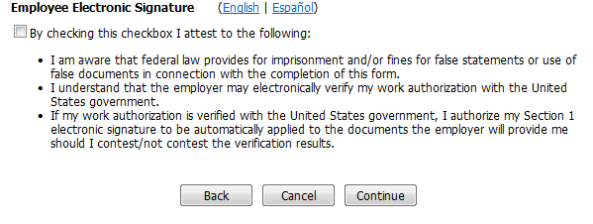
Electronic Signature Statement
Below is a larger image of what the new hire is attesting to when they electronically sign their I-9. The statement can also be read in Spanish.

Slide 16
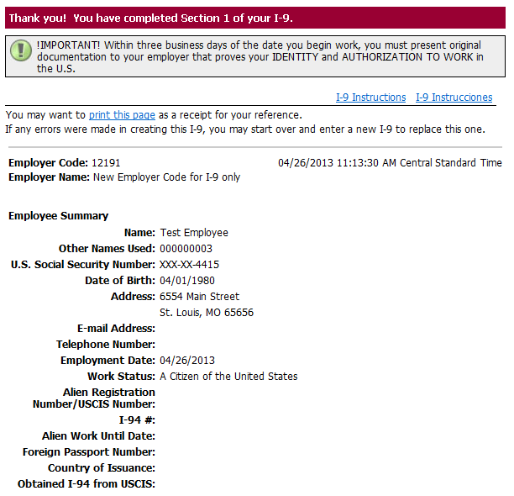
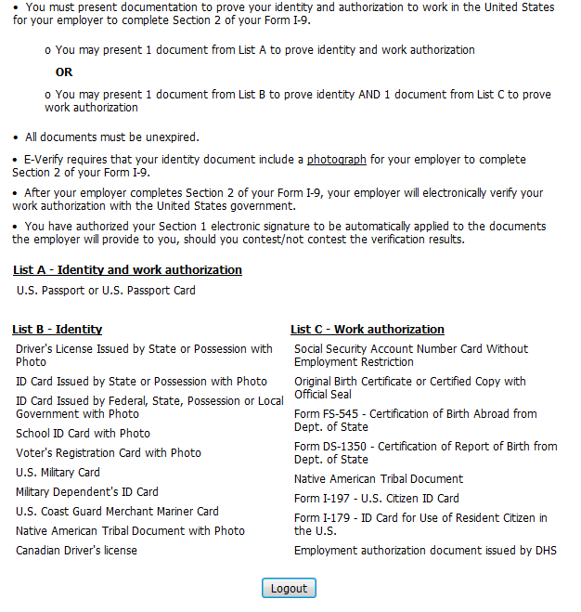
New Employee Process – Step 5
The new hire is presented with a link if they wish to print the I-9. Note: The SSN is masked for their protection.
In addition, the new hire will receive a customized list of documents needed for the completion of Section 2. The list of documents varies according to the citizenship status entered in Section 1 of the I-9.

Slide 17
New Employee Process is complete!
The new employee has now completed section 1 and logs out.
The employee will need to bring identification that proves identity and authorization to work in the United States, within 3 business days of the date they began work.
The printed receipt page can be kept by the new employee for their records.

Slide 18
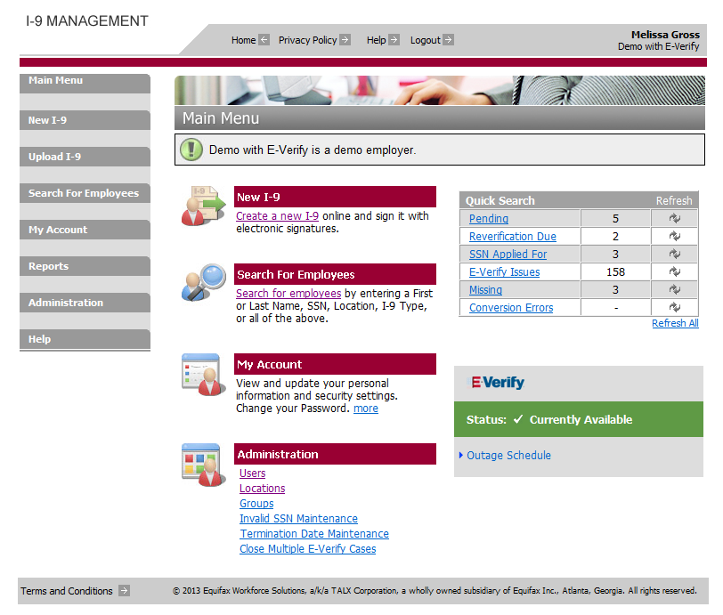
Verifier’s Responsibilities
The new hire will present their identification within 3 business days of the date of hire. The verifier will login with their MSU NetId and Password and authenticate to the Equifax I-9 System to complete Section 2. Once logged on, the verifier will find the Quick Search box in the top right corner. New hires who have completed Section 1 will be found in the Pending row. Upon first logging in, refresh one or all of the rows, by clicking the symbol in each row.

Slide 19
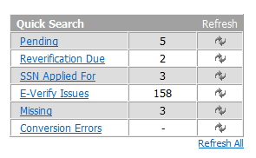
Quick Search Box
Pending – I-9’s with section 1 completed.
Reverifications Due – an employee’s work authorization is expiring so renewal process can be started.
SSN Applied For – employee has not yet received their Social Security Number.
E-Verify Issues – Any open E-Verify cases.
Missing – the employee has a record on The Work Number, but does not have an I-9 on file.
Conversion Errors – I-9’s that have been flagged with errors during the historical conversion process

Slide 20
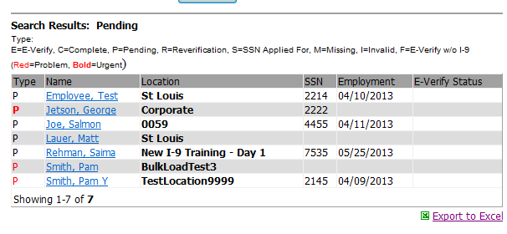
Verifier’s Responsibilities
The main responsibility of the verifier will be to complete section 2 of pending I-9s. To begin this process, click Pending in the Quick Search Box, then click the name of the employee from the list of pending I-9s.

Slide 21
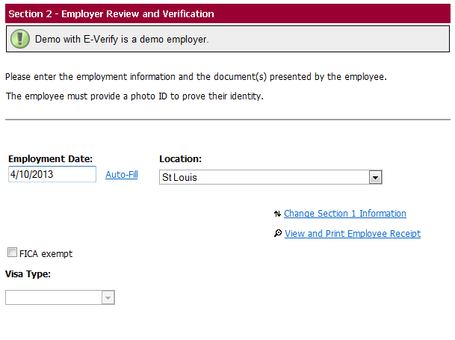
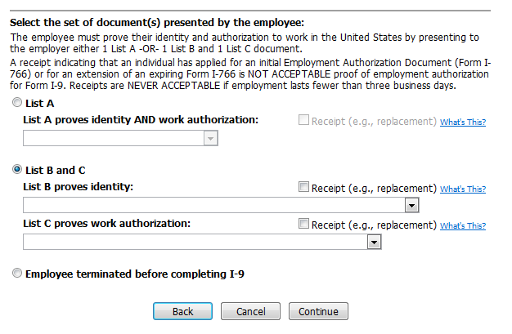
Verifier’s Responsibilities
Enter the date of hire. Select the location from the drop down menu.
Select the set of documents that were presented to you and click continue.

Slide 22
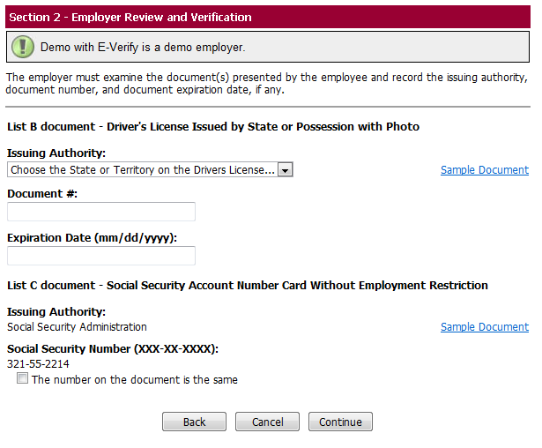
Verifier’s Responsibilities
Enter the data from the IDs into the system:
The Issuing Authority is typically on the document provided (SSA, State DMV, etc).
The document number is entered, along with an expiration date (if applicable), then click continue. All documents must be unexpired.

Slide 23
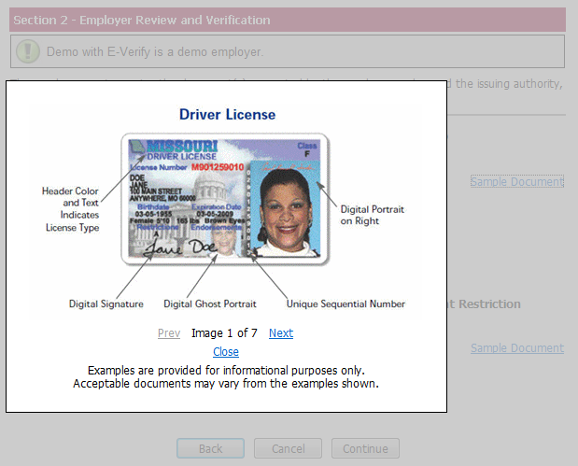
Verifier’s Responsibilities
NOTE:
If a document is presented from list B it must have a photo on it.
To see examples of each type of document listed, click Sample Document. Examples of documents are also availible in the Help menu.

Slide 24

Verifier’s Responsibilities
If an employee terminates before the I-9 is complete, select the radio button to indicate this, click continue and follow system instructions:

Slide 25
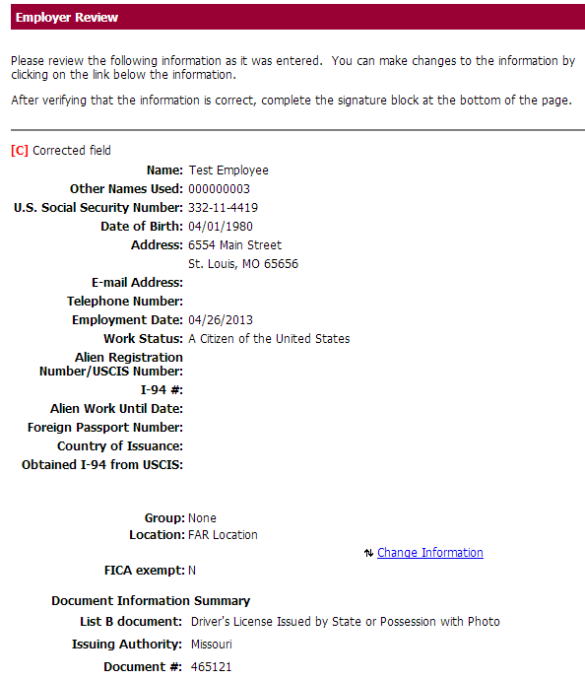
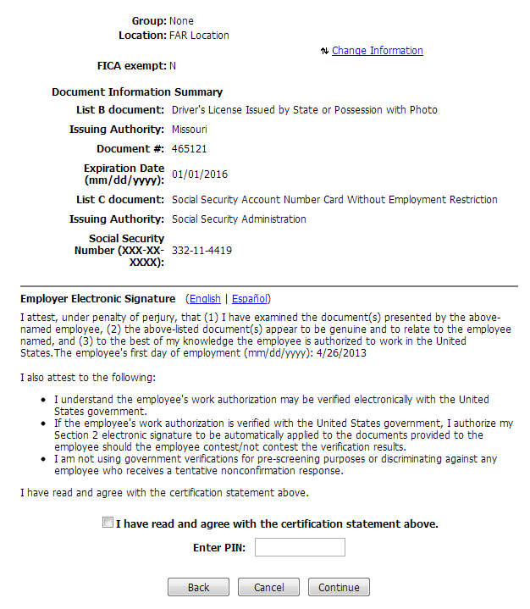
Verifier’s Responsibilities
On the Employer Review Page, carefully review the information that you have entered – this is your opportunity to correct any errors.
You will electronically sign, by checking the check box, entering your password, and clicking continue.

Slide 26
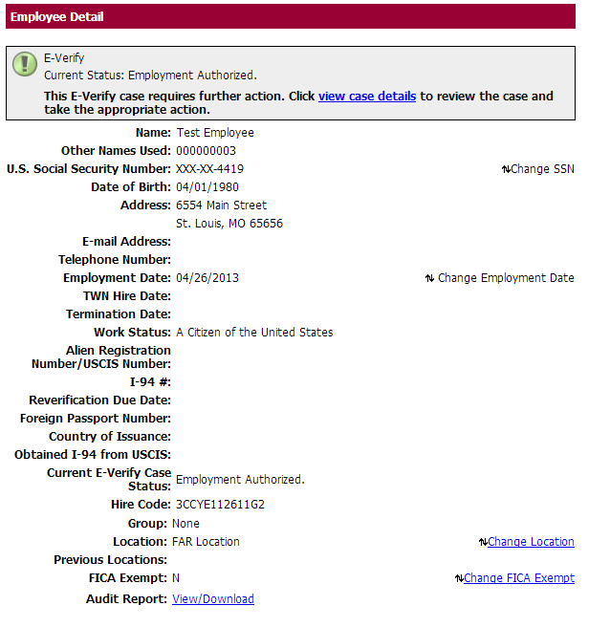
Verifier’s Responsibilities
The Employee Detail Page will display – this lets you know if you
have successfully completed the I-9.

