Slide 1
OSP Updates
Katie Cook, OSP; Vicki Spencer, OSP; Craig O’Neill, OSP Proposal Team 2; Diane Cox, OSP Contract Team 2; Pat Hampton, OSP Proposal Team 2; Denise Lator, OSP Proposal Team 2; Katie Winkler, OSP Contract Team 2

Slide 2
Agenda:
Introductions
Activity Log and Demo
Proposal Deadline Policy
Questions

Slide 3
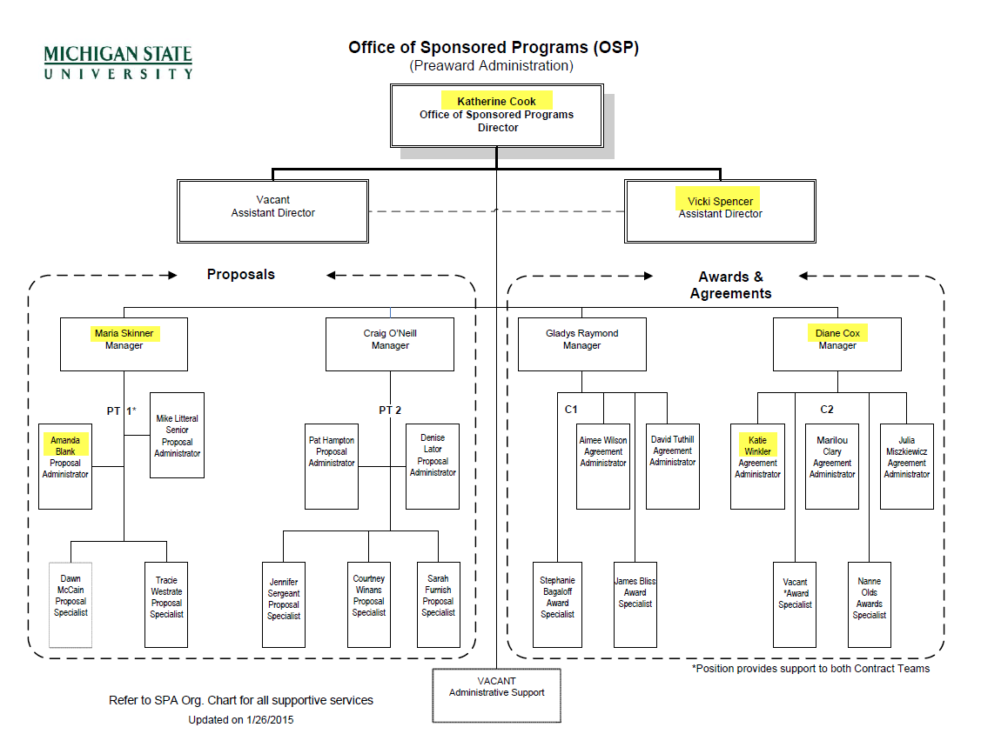
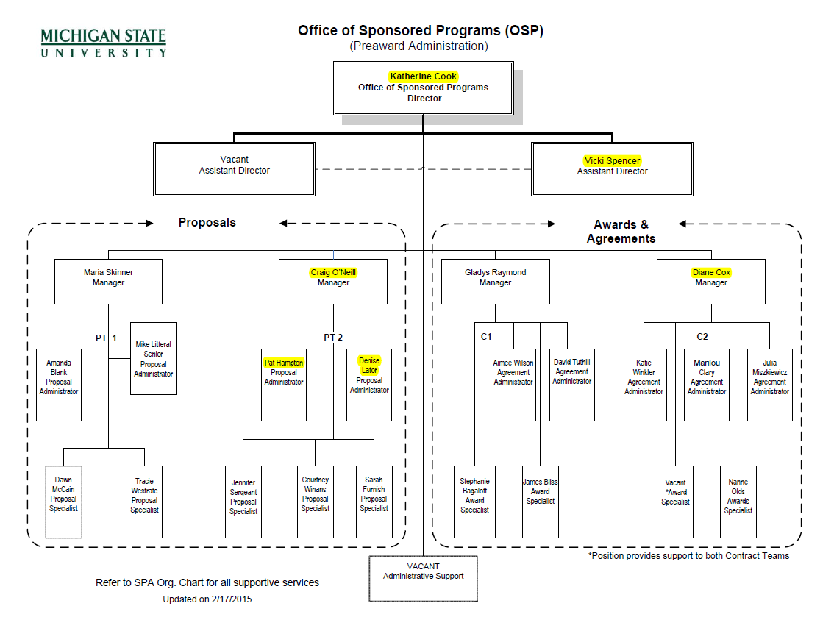

Slide 4
Increasing Transparency for Proposals and Awards
Purpose of Activity Log Project:
Transparency for the campus community:
in viewing the status of a proposal or award negotiation.
Better organization and tracking of activities:
enhanced cross-utilization of staff
the ability to prioritize workflow in a consistent manner.
More detailed, complete and consistent metrics:
providing tools to identify areas for increased efficiency and client support.

Slide 5
Activity Log
What is the Activity Log?
The activity log is a new system that tracks pre-award activities associated with proposals and awards. This system is now available for campus viewing. Activity Log was created to track metrics, provide transparency, and is an organization tool for OSP and Business Connect.
For additional information on how to use Activity Log, please see the Activity Log Viewer Guide.
Where is the Activity Log located?
www.osp.msu.edu

Slide 6
Key Points Proposal Deadline Policy: 10-6-3-1*
Ten business days:
Notification of proposal (including solicitation number when applicable) should be sent to OSP.
Six business days:
Final budget should be provided to OSP for review
Three business days:
Final proposal and eTransmittal should be provided to OSP for submission. If not, the proposal is considered to be a “late” proposal.
One business day:
“Late” proposal becomes an “at-risk” proposal/ needs Associate Research Dean Approval before OSP review and submission of proposal.
One business day:
OSP has committed to submit most “on-time” proposals one day before the deadline.
* To view the published policy:
https://cga.msu.edu/PL/Portal/DocumentViewer.aspx?cga=aQBkAD0AMwAwADEA
Proposal Preparation Guide: https://www.osp.msu.edu/PL/Portal/DocumentViewer.aspx?cga=aQBkAD0AMQAyADgA

Slide 7
Why the Deadline Is Important:
Risks*
Exceed system/ staffing capacity
System problems
Computer problems
File issues
Decrease time/ increase mistakes
Increase staff turnover
*Especially vulnerable during staffing transitions.

