Slide 1

NETWORK for BUSINESS ENGAGEMENT
A ONE-STOP Destination for Business, Industry, & Investor Engagement
Part of an integrated approach to University engagement with the private sector

Slide 2

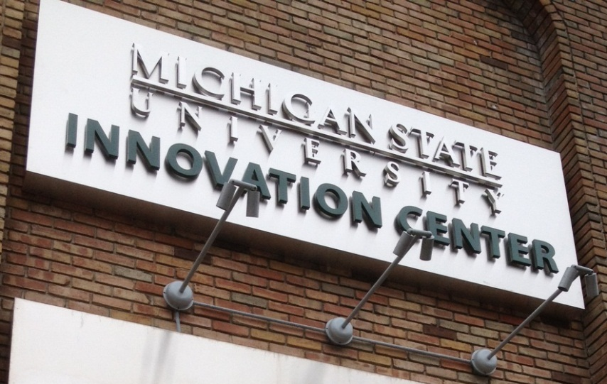

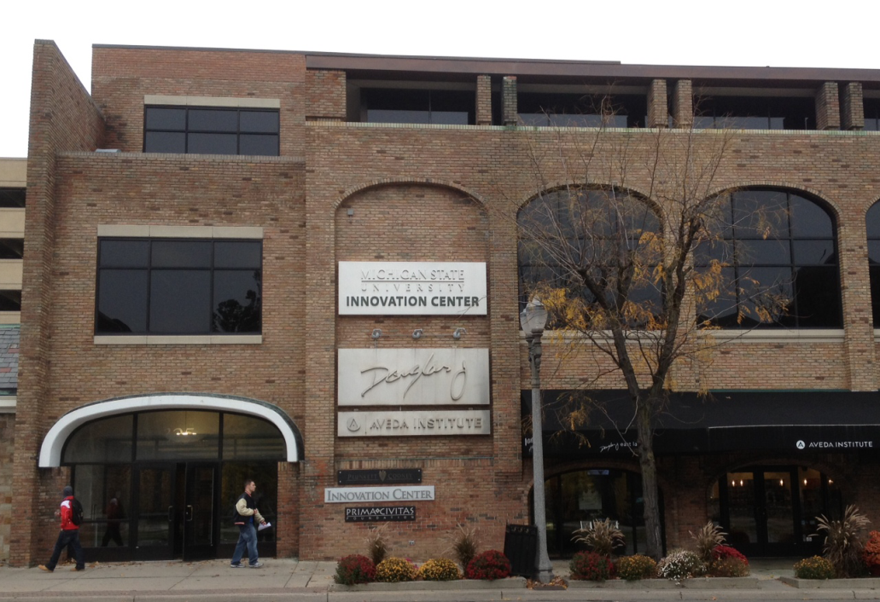


MSU’s place for connecting to the private sector

Slide 3
Our focus is Faculty – we’re here to make you more successful
Connecting your research to companies that are interested in what you do.
Company perspectives enrich your program
$11 Million in grants last year
Taking your ideas to the marketplace – seeing you ideas put to practice.
$4.2 million in royalty revenue last year
>$500,000 distributed to faculty
Creating companies from your ideas.
Professional help to create the best chance for success.
Engaging students in alternative careers.

Slide 4
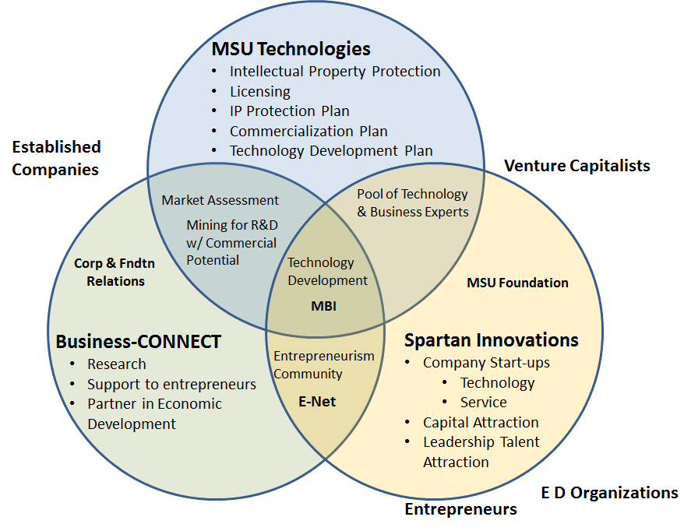

Slide 5
Part of an integrated approach to University engagement with the private sector
Licensing activities lead to further research investment or faculty engagement
Sponsored Research involves a negotiation of licensing terms and leads to follow-on engagements
Market and Patent research identify partners for licensing, sponsored research & philanthropy
Corporations donate money and goods, in exchange for access and visibility for hiring & collaborating
MSU-T
Spartan Innovations
Business-CONNECT
CFR
Each group has a focus – but we share relationships and we do our homework together.

Slide 6
Working as a team is critical to success, so the Innovation Center is organized as a unit under the VP for Research, with MSU Foundation ownership interest in SI.
OVPRGS
Steve Hsu
VP-Research & Grad Studies
Innovation Center
Charley Hasemann
Ass’t VP for Innovation & Economic Development
MSU Foundation
Business-CONNECT
Charley Hasemann
Executive Director, Bus-CONN
MSU Technologies
Rich Chylla
Executive Director, MSUT
Spartan Innovations, L3C
Dave Washburn
Executive Director, MSU Foundation

Slide 7
Working with Business-CONNECT
Research Collaborations with Company Sponsors
    Connecting our strength to their needs…

Slide 8

Stephen Hsu
VP Research
Charley Hasemann
Marta Palmer
Executive Assistant
Brice Nelson
Associate
Director
Jeff Myers
Associate
Director
Guangming He
Data Analyst
Randy Sheets
Contract Attorney
Charlene Fortin
Contract Admin
Tina Ramos
Contract Review

Slide 9
There are several groups that engage in different ways to established sponsored research at MSU:
Business-CONNECT
Corporate-sponsored Research and Fee-for-Service Agreements
Industry-sponsored Clinical Trials
OSP (Pre-award)
Federal Grants and Contracts
Foundation Grants
Federal Clinical Trials
Federal pass-through contracts – even through corporate channel (in cooperation with B-C)
CGA (Post-award)
Account creation and compliance monitoring for all awards

Slide 10
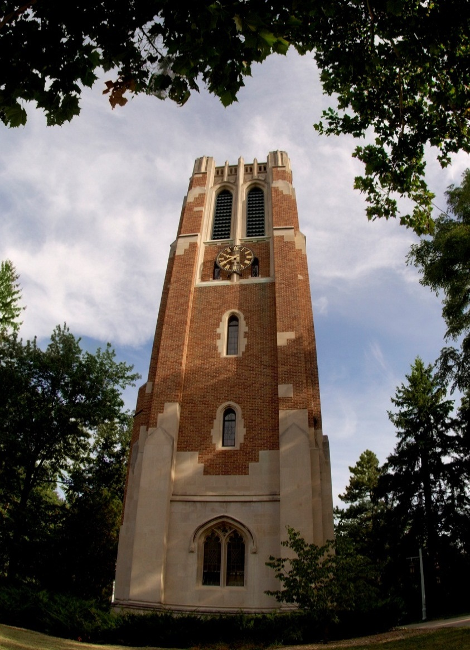
Business-CONNECT: The Front Door to MSU
Identify MSU Resources: we help companies find researchers & facilities; we navigate the university for them
Build Partnerships: we do proactive business development to build on strategic opportunities – bring us your ideas
One-Stop Shop: We act as an advocate for the deal, translating among stakeholders to find the win-win; we negotiate and sign the agreements

Slide 11
Working with MSU Business-CONNECT
MSU Network
Understand faculty needs and necessary resources to deliver.
External Business Partners
MSU Research
MSU Business-CONNECT
Conducting “Honest Broker” negotiations that bring all viewpoints to the table
Understand what the business really wants, and where there is room to negotiate.
Explain MSU policies.
BUILD RELATIONSHIPS.
Ensure deals fit University policies
MSU Admin and Policies

Slide 12
MSU’s goal is to develop the whole relationship
Get the graphic of partnership from Lucille
Adapted from “The Collaboration Imperative: Universities and Industry as Partners in the 21st Century Knowledge Economy.” Wayne Johnson, VP Hewlett-Packard April 25, 2006
Strategic Partner
Executive sponsorship
Joint partnerships
State Education lobbying
Major gifts
Business development
Sponsorship
University Initiative Sponsorship
Grad Student
Collaborative Research
Outreach
Education proposals
Support
Research
Workshops
Support contracts
Student Organizations
Philanthropic
Guest lectures
Involvement
Industry Affiliates
Research Grants
Internships
Consortia
Level of Engagement
Awareness
Career Fairs
Interviews
Phase One
Phase Two
Phase Three
Phase Four
Phase Five
Traditional Engagement
Holistic Engagement

Slide 13
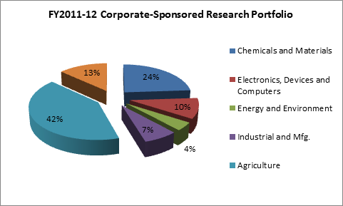
MSU has a large variety of industry partners

Slide 14
How can you work with Business-CONNECT?
Start early. As soon as you are aware of a possibility of partnering with industry, come to Business-CONNECT. Companies may need to move fast; the sooner you get us involved, the better we can match that pace.
Build relationships. MSU wants to build solid bridges to commercial partners. Engage with colleagues in industry when you meet them; treat a sponsored research project as a real partnership; follow through on obligations.
Protect MSU assets. Be aware of how your work can generate new intellectual property. Work with Business-CONNECT and MSU-Technologies by discussing any IP potential of your work.
Again, start early.

Slide 15
Working with MSU Business-CONNECT
What are the key aspects of a corporate research agreement?
Company and Faculty collaborate to create a clear description of project – the scope of work
Faculty and Business-CONNECT work together to develop an appropriate budget that captures the full cost of the project
We will always retain your right to publish
We will give the company rights to use your results for internal research, and we will negotiate their rights to make commercial use of the results
Our goal is ALWAYS to find a win-win balance. We want long-term partnerships
Engaging with us early is critical. We can help avoid the missteps that can make this hard.

Slide 16
How can you work with Business-CONNECT?
Generate draft protocol (statement of work) and budget for both agreement and transmittal processes
Start both processes in parallel – do this before you agree on budget with company
The Process:
AGREEMENT
Draft
Negotiate
TRANSMITTAL
Department
College
Execute (signature authority)
Review and acceptance
CGA:
Account, invoicing, compliance

Slide 17
A typical company-sponsored agreement is…
Fixed-price, non-reimbursable, no audit rights
Promise to deliver best effort
Full cost of the project, including IDC, but quoted as a single cost, or simplified budget.

Slide 18
Where do we stumble in this process?
  Promises made by faculty or staff that we can’t live up to
    Gift vs. grants, IDC rates, research vs. fee-for-service, budgets, etc.
  Companies that overreach – want to have too much control over publication or patents
Both can be fixed by engaging us early. We’re good at navigating these issues

Slide 19
Research vs. Fee-for-Service
“Research Project” means work which University conducts to uncover new and different trends or facts leading to a discovery. The pathway to discovery and the creativity of new ideas is in the hands of Principal Investigator (PI) and other University employees and usually starts as a Research Proposal which outlines a promising area of research. Research is an investigation aimed at the discovery and interpretation of facts, revision of accepted theories in light of new facts, development of new analytical and experimental protocols, or practical applications of such new theories, analysis, data gathering and experiments. University faculty, staff and employees may produce research results, materials and inventions, which lead to University Intellectual Property.
“Fee for Service Project” is work where the Deliverable requested is generated using known practical applications of standard procedures and established theories, methods and standard experiments. The results of such work are of specific interest to the sponsor and may involve off-the-shelf tools and established protocols. Fee-for-service projects do not include analysis or interpretation of data sets and the deliverables are limited to the results generated using the standard procedures, established theories, methods and experiments utilized in the performance of the work. There is no University Intellectual Property expected in this type of Project.

Slide 20
Contracts vs. Gifts (we like them both – but they’re different)
Gift #1: A gift is a “non‐reciprocal transfer with no implicit or explicit statement of exchange, procurement of services or provision of exclusive information” (CASE). There is no Quid Pro Quo and benefits would accrue to the general public. The gift’s purpose or use may be restricted or unrestricted.
Gift #2: An unconditional, voluntary, non‐reciprocal transfer of assets (including unconditional promises) from a private entity to a not‐for-profit organization. The donor may have certain expectations but there cannot be any actual control over expenditure of funds or any quid pro quo. The donor may not benefit from the execution of the gift.

Slide 21
Contracts vs. Gifts (we like them both – but they’re different)
Contract #1: A contract is a legally enforceable agreement between two or more parties with mutual obligations.
Contract #2: A contract is an agreement between two or more competent parties in which an offer is made and accepted, and each party benefits.
• Research can clearly be supported by a gift
• Gift classification must be bona fide (e.g., not just to avoid indirect cost assessment)
• Gift classification does not alter:
  – legal risks and accountability associated with research
  – treatment of research for cost accounting purposes.

Slide 22
How can you work with Business-CONNECT?
Generate draft protocol (statement of work) and budget for both agreement and transmittal processes
Start both processes in parallel – do this before you agree on budget with company
The Process:
AGREEMENT
Draft
Negotiate
TRANSMITTAL
Department
College
Execute (signature authority)
Review and acceptance
CGA:
Account, invoicing, compliance
Talk to
Business-CONNECT
re: Gift vs. Grant
Research vs.
Fee-for-Service
Export Control, IRB,
etc.

Slide 23
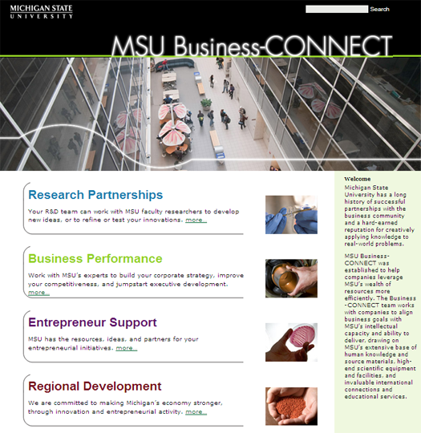
Visit us at our
web portal…
http://innovationcenter.msu.edu
325 E. Grand River Ave., Suite 375
East Lansing, Michigan 48823
517-884-2370
FAX: 517-884-2373

Slide 24
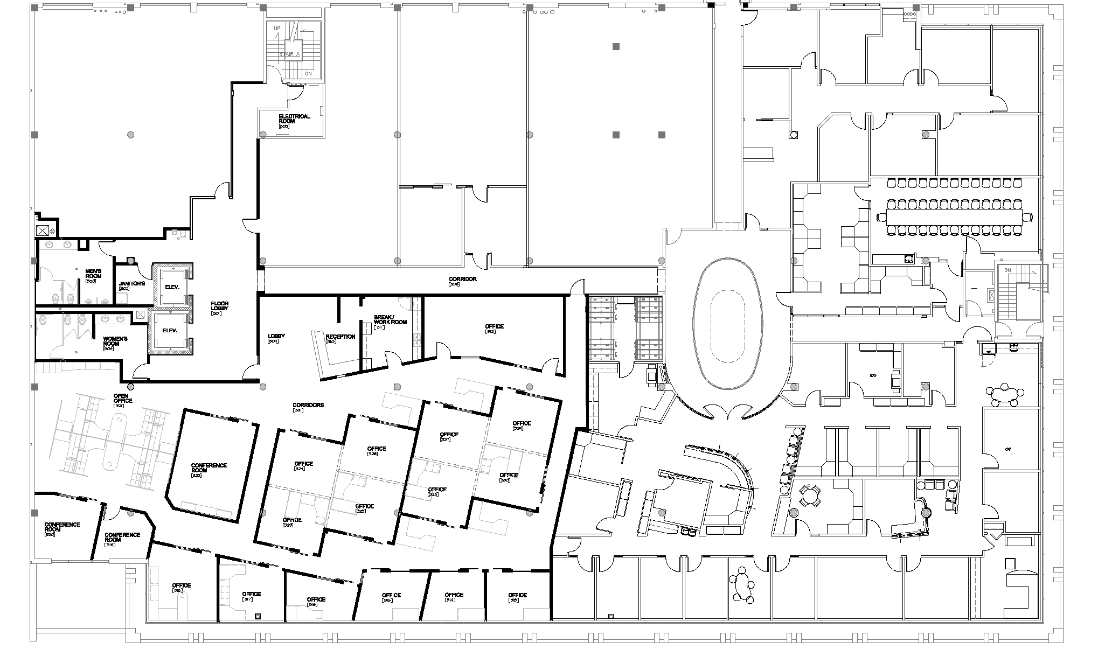



MSU’s place for connecting to the private sector
- come visit any time
300
Room
Q&A
325 E Grand River, 3rd floor. (Used to be Jacobson’s department store)

