Slide 1
MSU Cognos Future
Data Services
September 2015

Slide 2
Cognos 10.2.2 Improvements
Architecture
64- bit vs 32- bit
More server power, faster servers
Ghost issue resolution
Workspace
User-built dashboards
Pre-built content
Workspace Advanced
New ad hoc tool
Can assign specific capabilities to user groups
Graphics
Improved and animated visualizations

Slide 3
Cognos 10.2.2 Improvements
Cognos Mobile
Interactive reports for mobile and tablets
Security
More granular user profiling
My Data Sets/External Data
Select users can upload their own data
Usability changes
Reports
Consolidated report display of select reports
More efficient, less confusing

Slide 4
MSU Interface
Providing a more visual navigation
Tiles combined with images
Larger than the folder structure therefore easier to navigate
Opens in new tab with location indication
Customized greeting
Announcement space below
MSU Colors

Slide 5
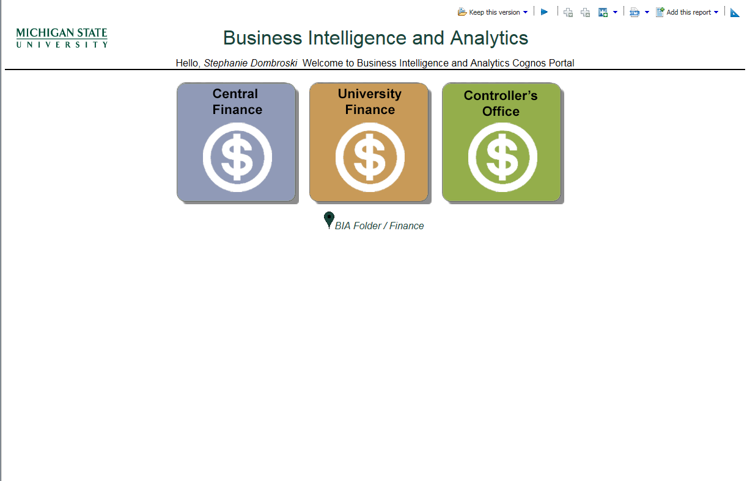
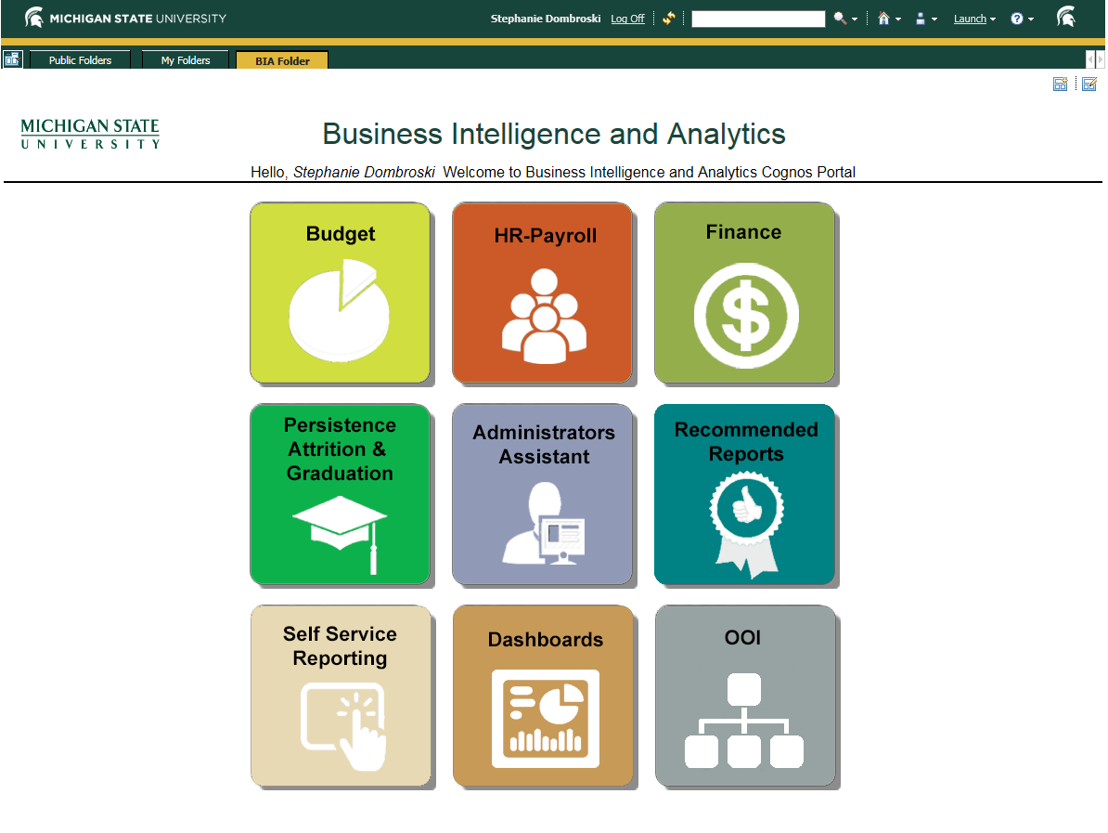
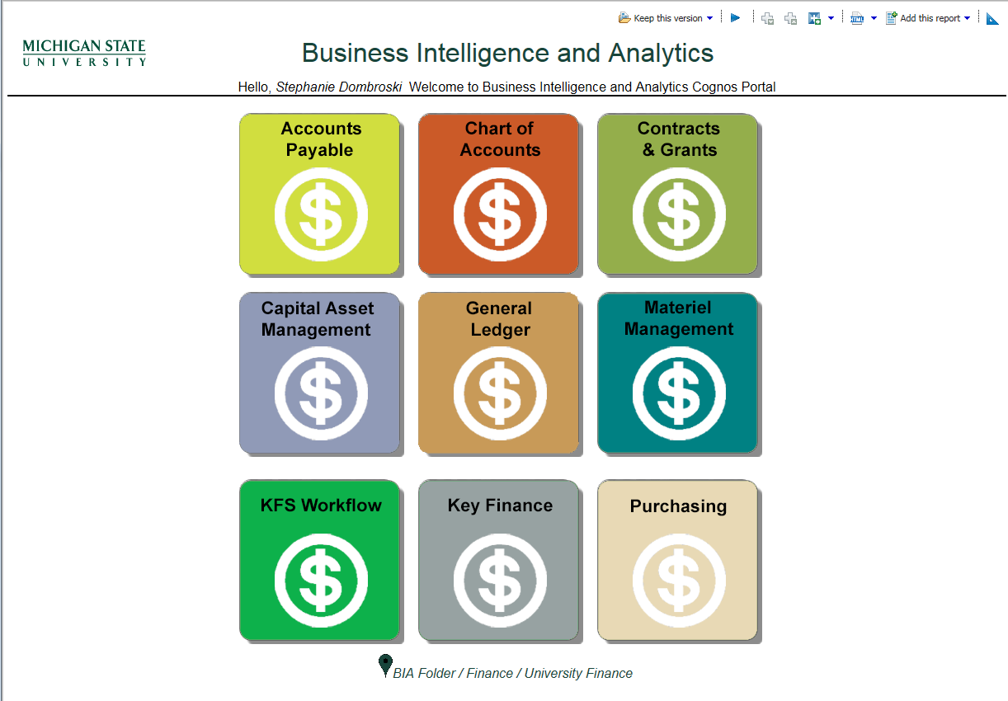
Tiles
Notes:
Consulted with other universities and usability related requests coming from you guys. Announcements for different areas
Colors

Slide 6
Report Improvements
Streamlined report design
Better performance, less clicking
Option to run several different reports from same page
Ability to easily and quickly see most commonly used information

Slide 7
Labor Distribution Lite

Slide 8
Cognos Workspace
Build your own dashboards
Users can use prebuilt items
Global filters
Ability to build, change visualization/layout/global filter/color/resize
Drill through to detail
Enhanced visualization

Slide 9
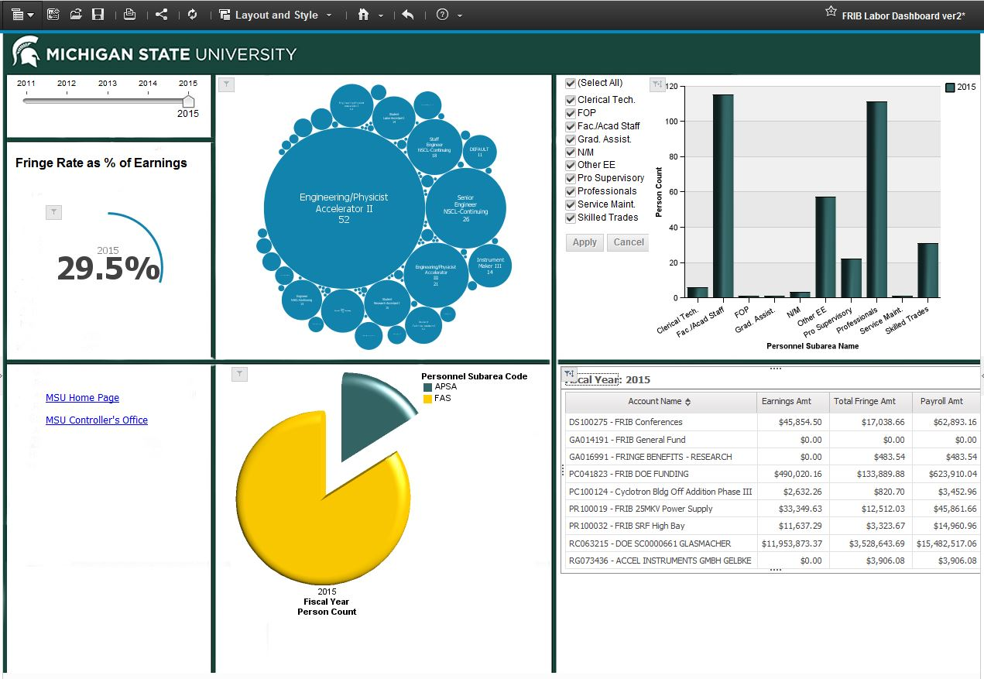

Slide 10
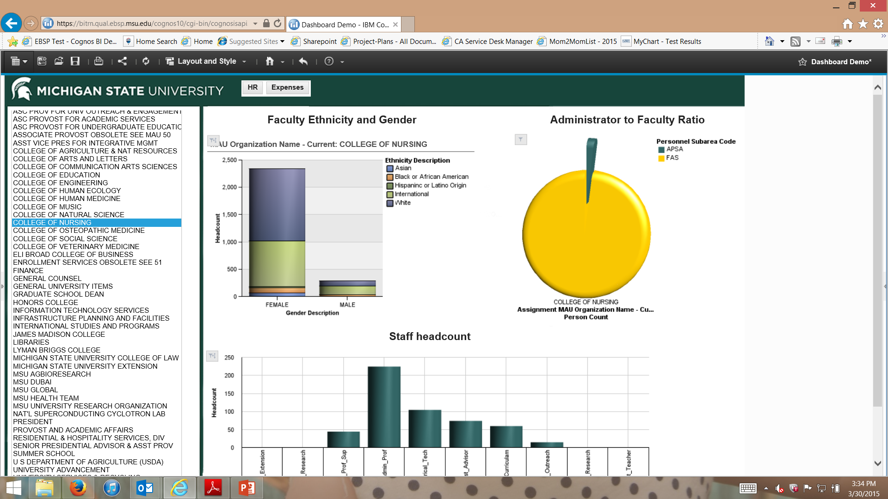

Slide 11
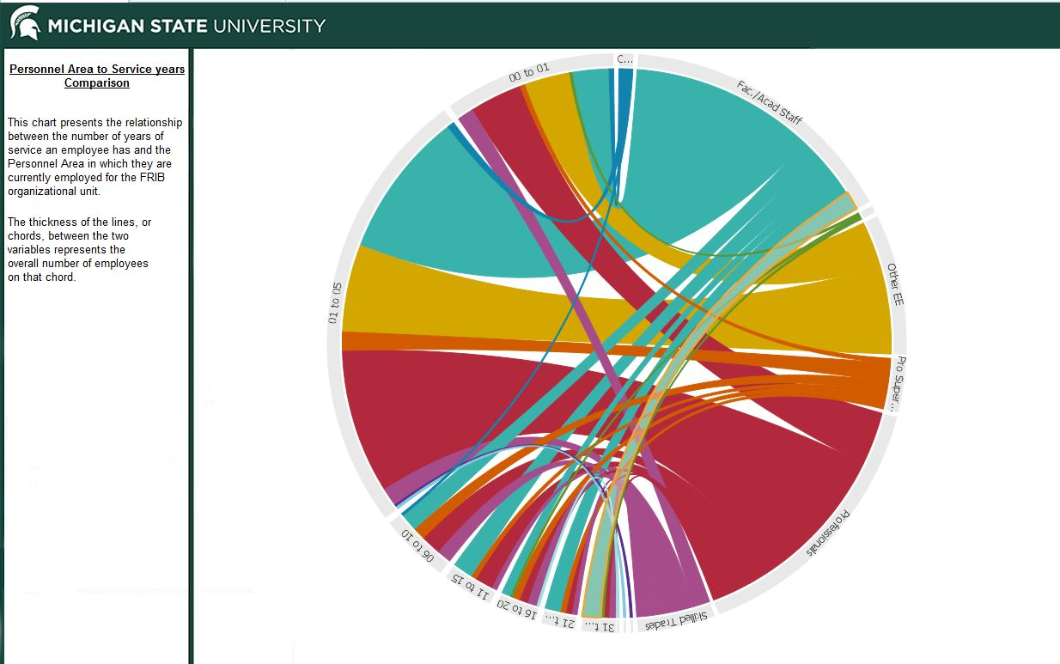

Slide 12
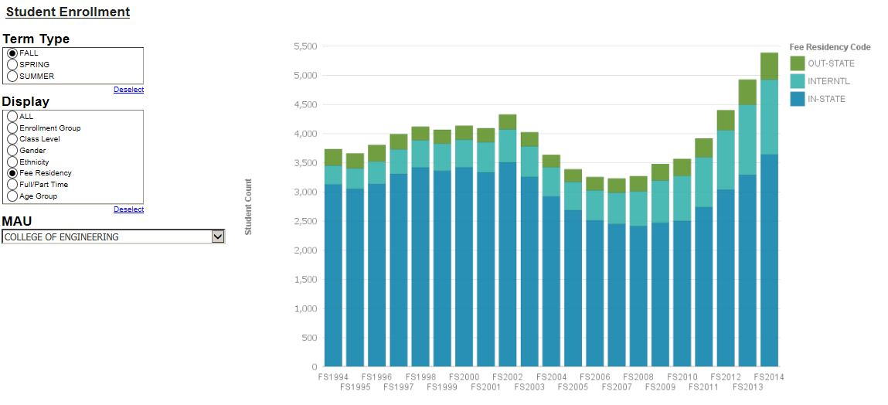

Slide 13
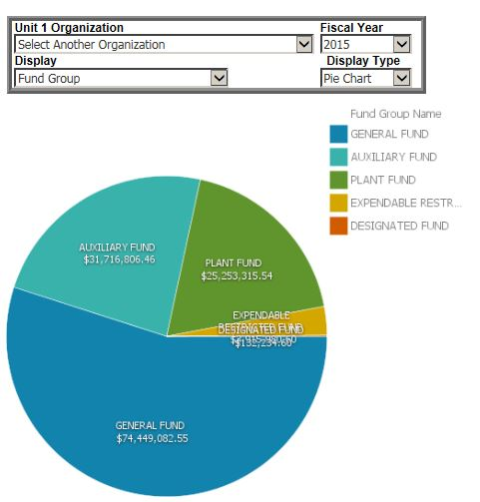

Slide 14
My Data Sets
Ability to bring and report on your own data
Upload and publish packages
Utilize your own data in your own dashboards
Use your own data for Query Studio
Sharing your data within your colleagues
Upload delimited text or Excel file, create reports and dashboards
Administer the access for your own data
Notes:
Working with units about their data- Setting up the limits right now and working with certain units
Security giving access

Slide 15
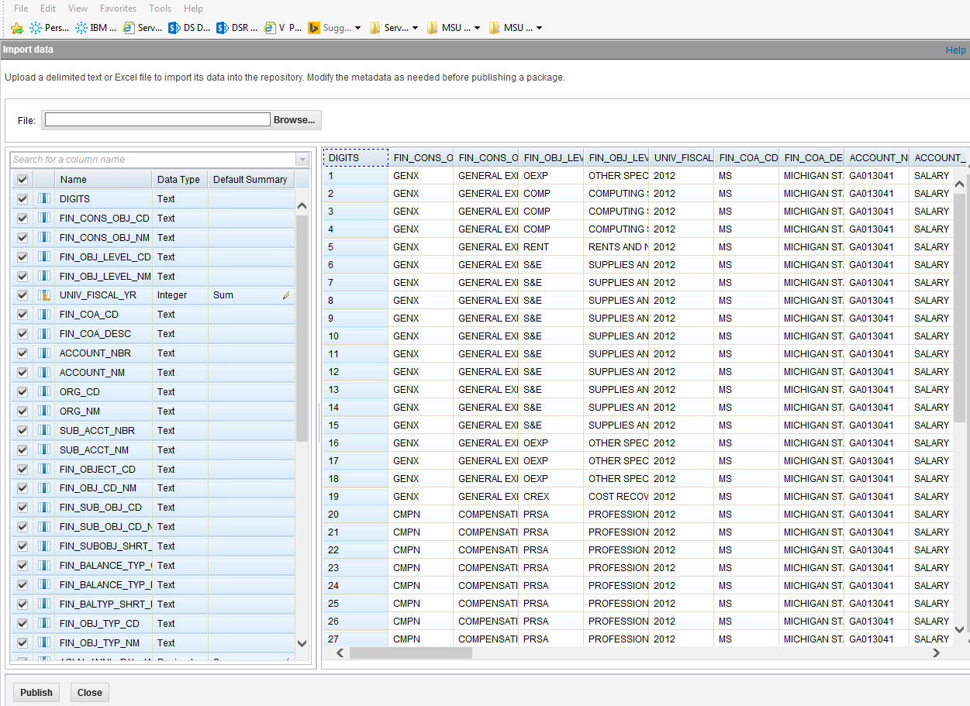
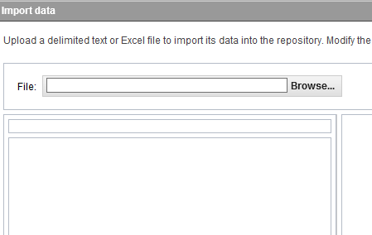

Slide 16
Mobile
Active Reports
Data and Report packaged
Available to view on browser also
Cognos Apps for IOS and Android platforms
Interactive
Off-Site Access

Slide 17
Event Studio
Tool to define and monitor business events
Eg. change in expenditures over time
Alert decision makers and facilitate agile responses
Agents to perform tasks and send alerts when specific conditions within the University’s data are met.
Notes:
For example, an agent can be created to monitor when the Expenses Before Encumbrances for a specific account reach a certain numeric threshold, such as $1 M, or a percent threshold of the Expense Budget, such as 90%. When the specific condition is reached, the agent can be set to send an email alert to the Fiscal Officer so that action can be taken prior to the account overspending its budget.

Slide 18
Other Cognos 10.2.2 Functionalities

Slide 19
Cognos Workspace Advanced

Slide 20
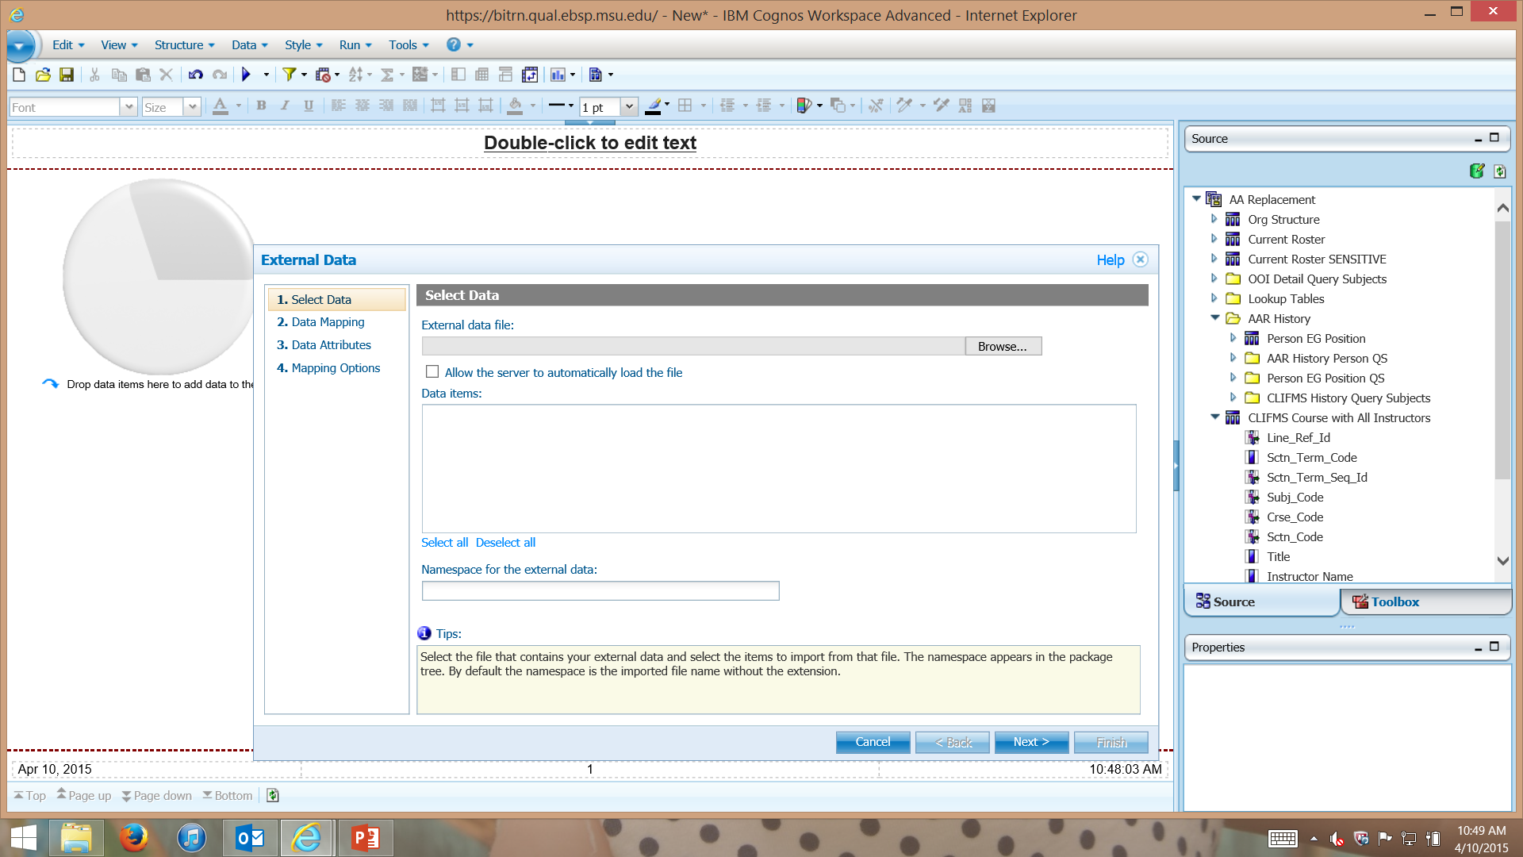
External Data

Slide 21
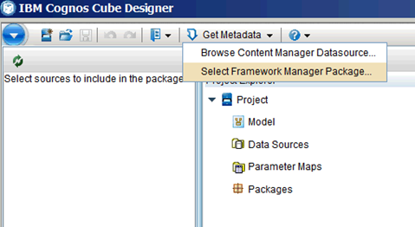
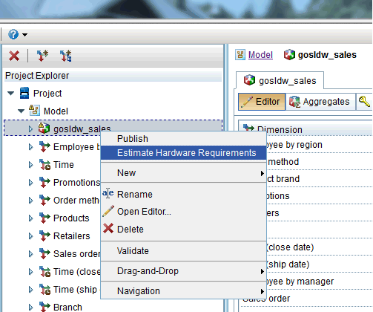
Dynamic Cubes
Proactively plan using the Cube Designer Hardware Sizing Guide

Slide 22
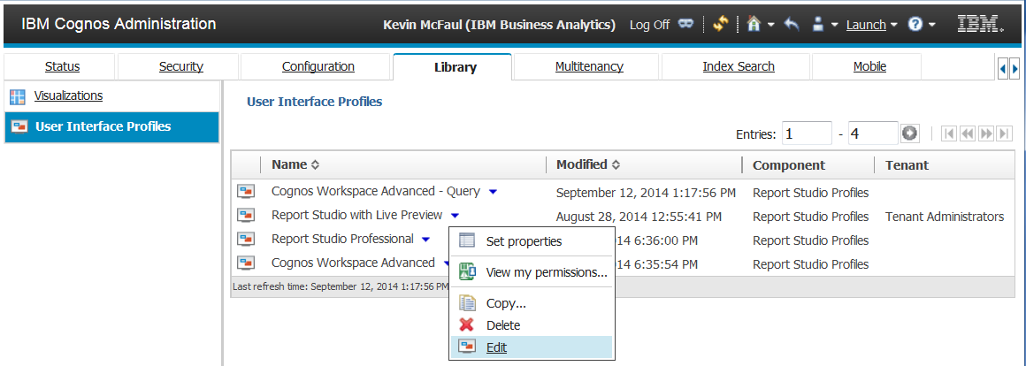
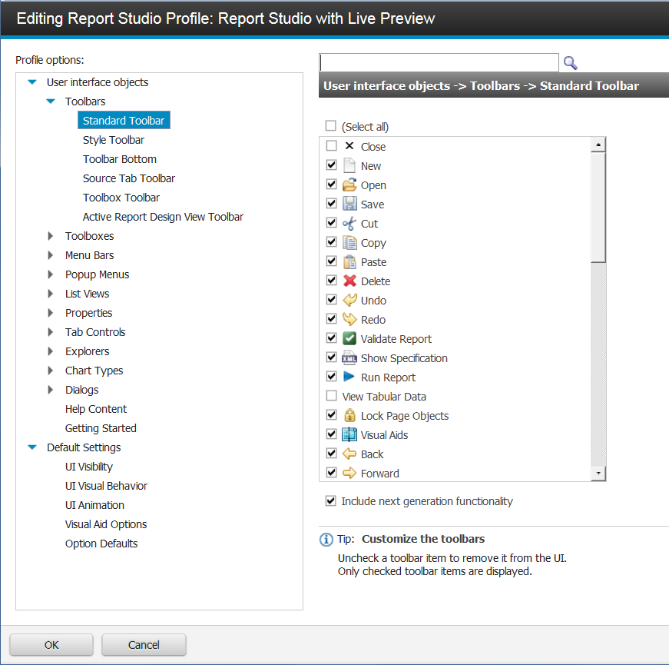
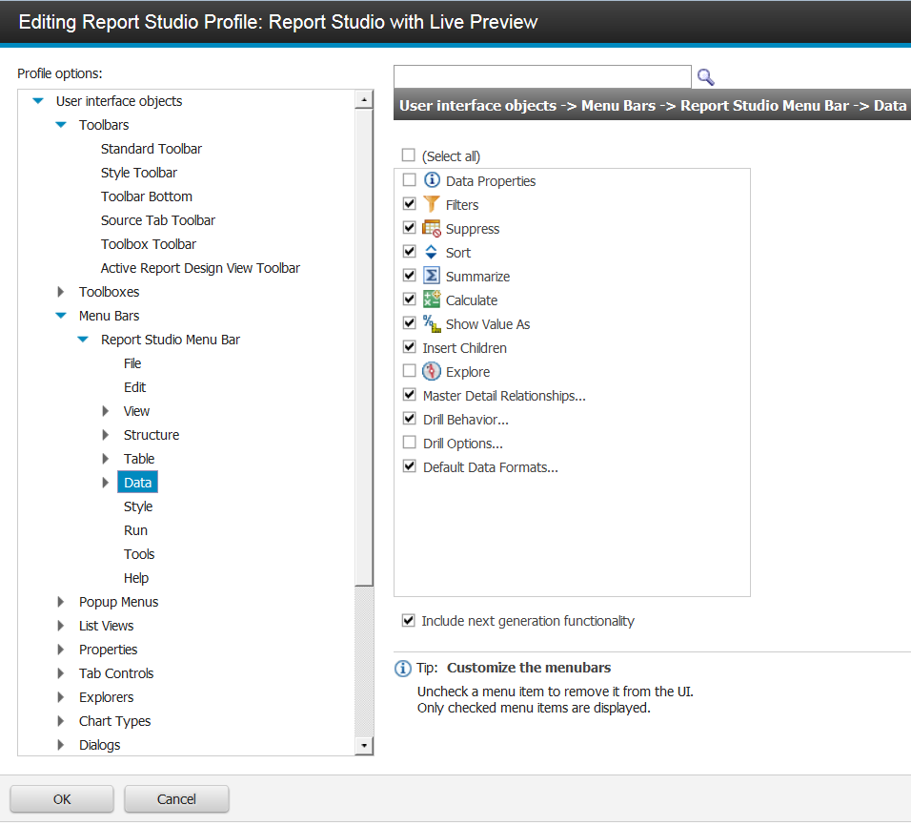
Targeted Profiles
Customize profiles in
IBM Cognos Report Studio & IBM Cognos Workspace Advanced
Views based on skill and required functionality
Enables more users to be Self-Sufficient
Notes:
[Src: MaAl]

Slide 23
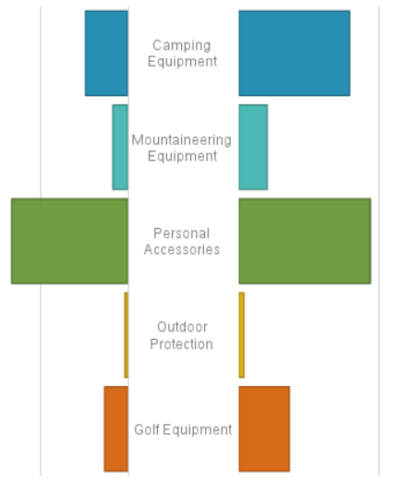
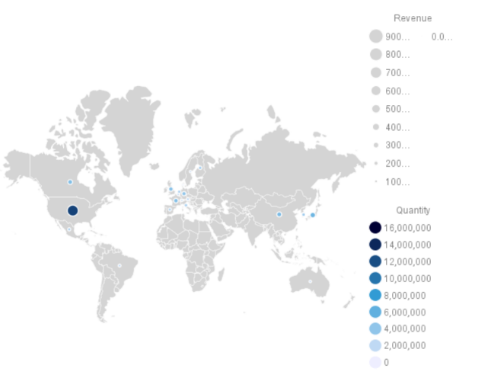
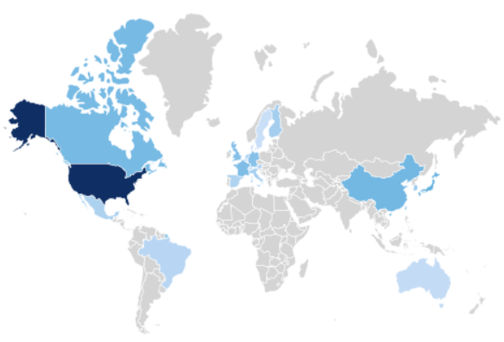
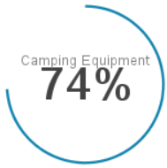
New Visualization Capabilities
New visualizations including, Tornado, Geospatial, Chord, and Combination
Updated Visualizations to contain properties
Notes:
New and Innovative Visualizations include
Polar Area
Chord
Tornado
Combination
Marimekko
Extensible Visualization Properties in Report Studio & CWA provide the ability to show:
Legends
Show values
Chart titles
Fonts
Visualization dependent properties
Extensible visualization data slots are now flexible, use only those that you need.

Slide 24
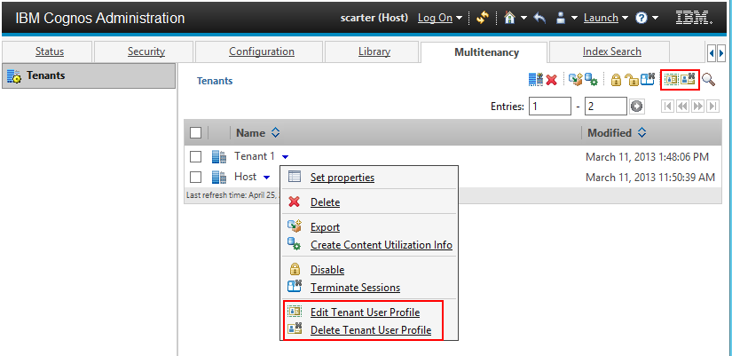
Improvements in Deployment
Delegate Administration without providing system wide administration
Share content across tenants
Allows users to be part of multiple tenants
Notes:
Bounded tenants

