Slide 1
Residential Property Values
And Wind Turbines:
A Summary of Findings
Ben Hoen
Lawrence Berkeley National Laboratory
Michigan Wind Forum
March 10th, 2011
This presentation was made possible in part by funding by the U.S. Department of Energy, Office of Energy Efficiency and Renewable Energy, Wind & Hydropower Technologies Program

Slide 2
Impacts on Residential Property Values Near Wind Turbines
Wind Energy and Property Values
  Overview of Subject
  Previous Literature
  Berkeley Lab Research
  Other Disamenity Research
  Conclusions

Slide 3
Proximity to and Views of Environmental (Dis)Amenities Can Impact Property Values
Highway
Transmission Lines
Average Home
Green Space
Ocean Front
↓$
↑$
↓ $
↑$
This linkage is well studied generally,
but not for wind facilities,
but that is changing.

Slide 4
Property Value Concerns for Wind
Fall Into Three Potential Categories
No one will move here!
Area Stigma: Concerns that rural areas will appear more developed
Scenic Vista Stigma: Concerns over decrease in quality of scenic vistas from homes
Nuisance Stigma: Potential health/well-being concerns of nearby residents
It will ruin my view!
I won’t be able to live in my home!
Each of these effects could impact property values;
none are mutually exclusive

Slide 5
Impacts on Residential Property Values Near Wind Turbines
Wind Energy and Property Values
  Overview of Subject
  Previous Literature
  Berkeley Lab Research
  Other Disamenity Research
  Conclusions

Slide 6
Relatively Few Robust Wind and Property Studies Exist
Variety of methods used, from surveys to sales analyses, with varying levels of sophistication
Some methods are not conventional based on the previous literature
Some analyses use very small samples on which they base conclusions
Results are diverse, and in many instances unpersuasive due to limitations to the data and methodology.

Slide 7
What Conclusions Can Be Drawn From The Previous Literature When Looking At It Together?
Wind facilities have often been predicted to negatively impact property values (e.g., Haughton; Firestone et al.; Kielisch; McCann)
Some convincing evidence exists of impacts occurring after announcement but prior to construction (Hinman)
In general, impacts, to the degree that they exist, are most likely very near turbines (e.g., where they can be heard) (McCann)
Experts (e.g., appraisers, assessors, realtors) when surveyed after construction have mixed opinions as to actual effects (Grover; Goldman; Crowley; McCann; Kieliesh; Poletti)
When actual sales are investigated after construction using accepted techniques evidence of impacts has failed to materialize (Hoen; Sims & Dent; Sims et al., Hinman, Canning & Simmons)

Slide 8
Impacts on Residential Property Values Near Wind Turbines
Wind Energy and Property Values
  Overview of Subject
  Previous Literature
  Berkeley Lab Research
  Other Disamenity Research
  Conclusions

Slide 9
Berkeley Lab Project Involves Most Data-Rich and Comprehensive Analysis To Date
Research Questions
Is there evidence that views of turbines measurably affect sales prices?
Is there evidence that proximity to turbines measurably affect sales prices?
Do the results change over time, and are there other observable impacts?
Relevance
Provide stakeholders in siting/permitting processes greater confidence in the likely effects of proposed wind energy facilities, allowing greater consensus on often-contentious setback requirements, viewshed valuations and non-participating landowner arrangements.
Team
B. Hoen (LBNL), R. Wiser (LBNL), P. Cappers (LBNL),
M. Thayer (San Diego State University), G. Sethi (Bard College)
Funder
U.S. Department of Energy, Office of Energy Efficiency and Renewable
Energy, Wind & Hydropower Technologies Program

Slide 10
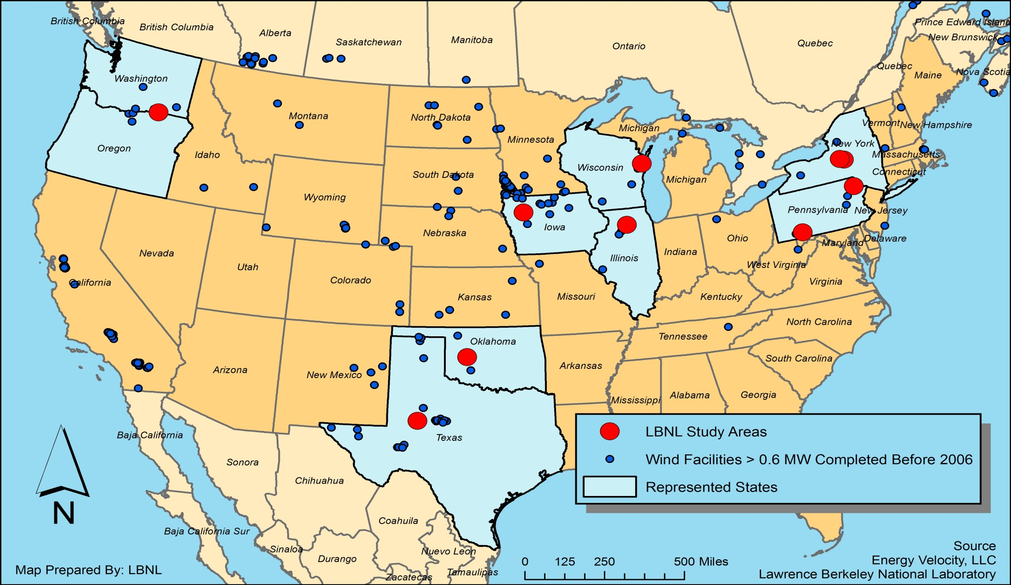
Collected Sales Data from 10 Study Areas
Surrounding 24 Wind Facilities in 9 States
7,459 Residential Sales Transactions
1,754 Pre-Announcement, 4,937 Post-Construction, and
768 Post-Announcement-Pre-Construction
3 Adjoining Counties
Washington & Oregon
7 Facilities: 582 WTG,
790 Sales
Kewaunee Cnty, WI
2 Facilities: 31 WTG,
810 Sales
Madison Cnty, NY
Area 1: Madison
7 WTG, 463 Sales
Madison Cnty, NY
Area 2: Fenner
20 WTG, 693 Sales
Wayne Cnty, PA
43 WTG,
551 Sales
Buena Vista Cnty, IA
5 Facilities: 381 WTG,
822 Sales
Lee Cnty, IL
103 WTG,
412 Sales
Somerset Cnty, PA
3 Facilities: 34 WTG,
494 Sales
Custer Cnty, OK
2 Facilities: 98 WTG,
1,113 Sales
Howard Cnty, TX
46 WTG,
1,311 Sales

Slide 11
Homes Nearest the Turbines Were Depressed in Value Before Construction and Appreciated After Construction While Homes Further Away Were Largely Unchanged Over Time

Slide 12
Sales Volumes Near Turbines Slowed Slightly After Construction, Then Returned To More Normal Levels

Slide 13
Conclusions Based On
All Of The Analyses In The Report
Area Stigma: There is an absence of evidence that sales prices of homes without views of turbines and further than one mile from the nearest turbine are stigmatized by the arrival of facility
Scenic Vista Stigma: There is an absence of evidence that sales prices of homes with a view of the turbines are uniquely stigmatized even if that view is “dramatic”
Nuisance Stigma: There is an absence of evidence that prices of sales occurring after construction of the facility for homes within a mile of the nearest wind turbine in this sample are affected
Therefore, if effects do exist in this sample, they are either too small and/or too infrequent to result in any statistically observable effect

Slide 14
Impacts on Residential Property Values Near Wind Turbines
Wind Energy and Property Values
  Overview of Subject
  Previous Literature
  Berkeley Lab Research
  Other Disamenity Research
  Conclusions

Slide 15
Property Value Effects Found Near Other, Potentially More Risky, Disamenities Are In-Scale With Those For Wind Energy

Slide 16
Effects Found Near Other, Potentially More Risky, Disamenities Are Relatively Small And Fade Quickly
Homes within 1 mile of superfund sites, waste transfer stations, power plants, crematoriums, lead smelters have been found to decrease in value by no more than roughly 16% with most decreasing only roughly 8%
Homes adjacent to landfills have been shown to decrease in value by 0% to 13%, depending on landfill volume, with all effects fading outside of 2 miles
Homes located in areas with groundwater contamination have been shown to decrease in value by 7%, with no effects found after remediation
Homes adjacent to high voltage transmission lines have been shown to decrease in value by roughly 8%, with all effects fading outside of roughly 350 feet
Homes adjacent to noisy roads have been shown to decrease in value by roughly 4%, as compared to homes on quiet roads, with 10 dB (A) lower sound levels

Slide 17
Impacts on Residential Property Values Near Wind Turbines
Wind Energy and Property Values
  Overview of Subject
  Previous Literature
  Berkeley Lab Research
  Other Disamenity Research
  Conclusions

Slide 18
Conclusions From All Research Regarding Property Value Impacts From Wind Energy
Risks of property value impacts are highest when they cannot be accurately quantified, such as in the period after announcement yet prior to construction. Some evidence exists to support this.
Property value impacts after construction are most likely to exist near turbines (e.g., within earshot), and fade with distance and potentially time
Given current research, economically significant impacts are not likely to exist outside of 1 mile even if turbines are visible
Effects inside of one mile are not likely to be larger than other more risky disamenities (e.g., superfund sites)
And more to the point, conclusive evidence of effects from wind facilities have not been discovered inside of one mile despite a number of studies using a variety of sophisticated statistical techniques

Slide 19
Thank You!
  Ben Hoen
  Lawrence Berkeley National Laboratory
  bhoen@lbl.gov
For a copy of the full LBNL report: “The Impact of Wind Power Projects on Residential Property Values in the United States: A Multi-Site Hedonic Analysis”, go to: http://eetd.lbl.gov/ea/ems/re-pubs.html
For a copy of the journal paper: Hoen, B., Wiser, R., Cappers, P., Thayer, M. and Sethi, G. (Forthcoming) “Wind Energy Facilities and Residential Properties: The Effect of Proximity and View on Sales Prices”. Journal of Real Estate Research. Go to: http://aux.zicklin.baruch.cuny.edu/jrer/papers/abstract/forth/accepted/jrer_156%28F100413R2%29.htm
This presentation was made possible in part from funding by the Office of Energy Efficiency and Renewable Energy, Wind & Hydropower Technologies Program of the U.S. DOE

